Slide 1
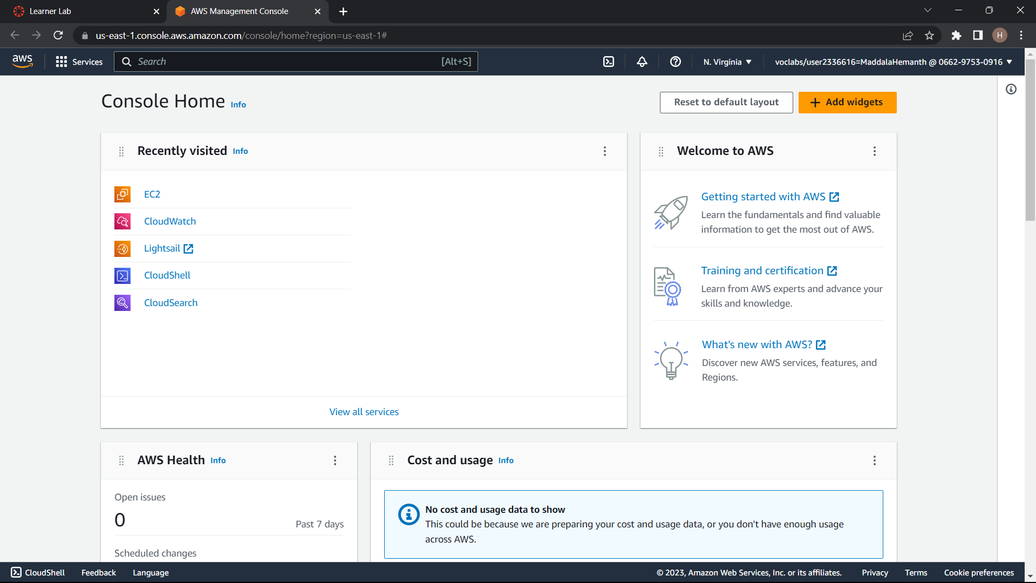
Creating an EC2 Instance
Step1:start the lab . click on the aws
Step2:click on the EC2

Slide 2
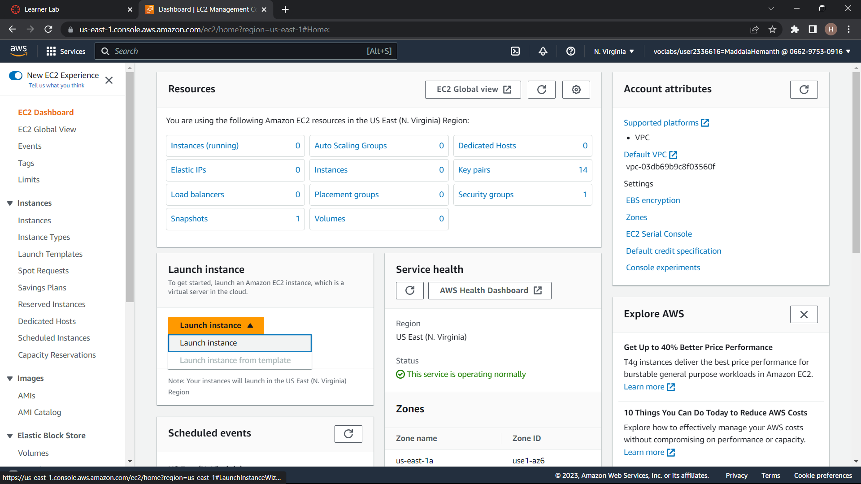
Step3:click on launch instance

Slide 3
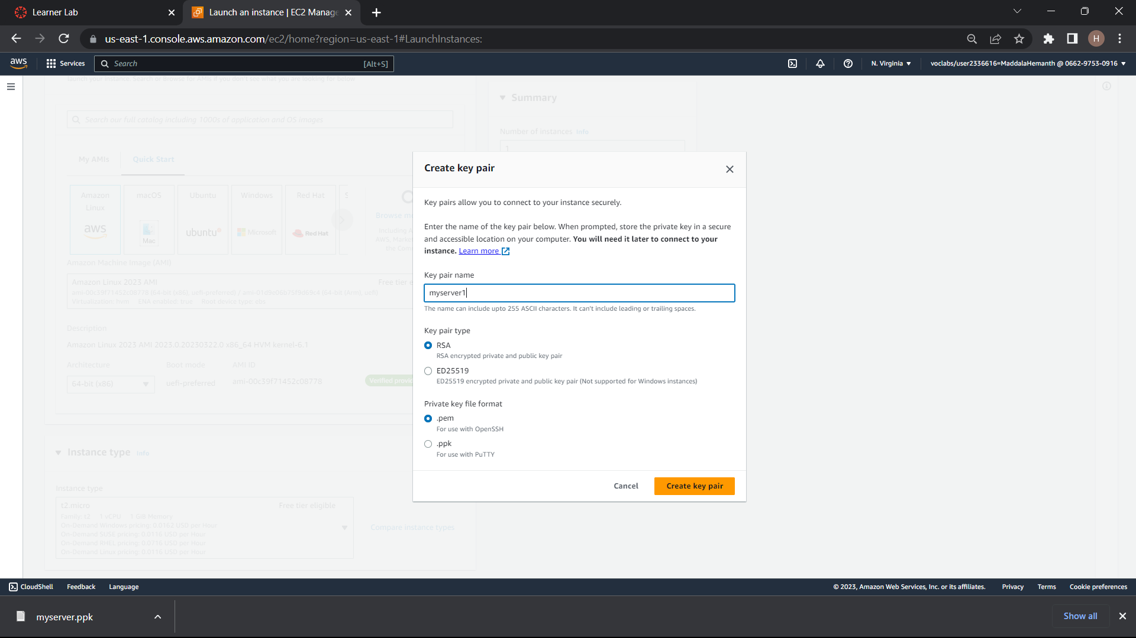
Step4:Give a name to your instance . Select MY AMIs and also create a new key pair

Slide 4
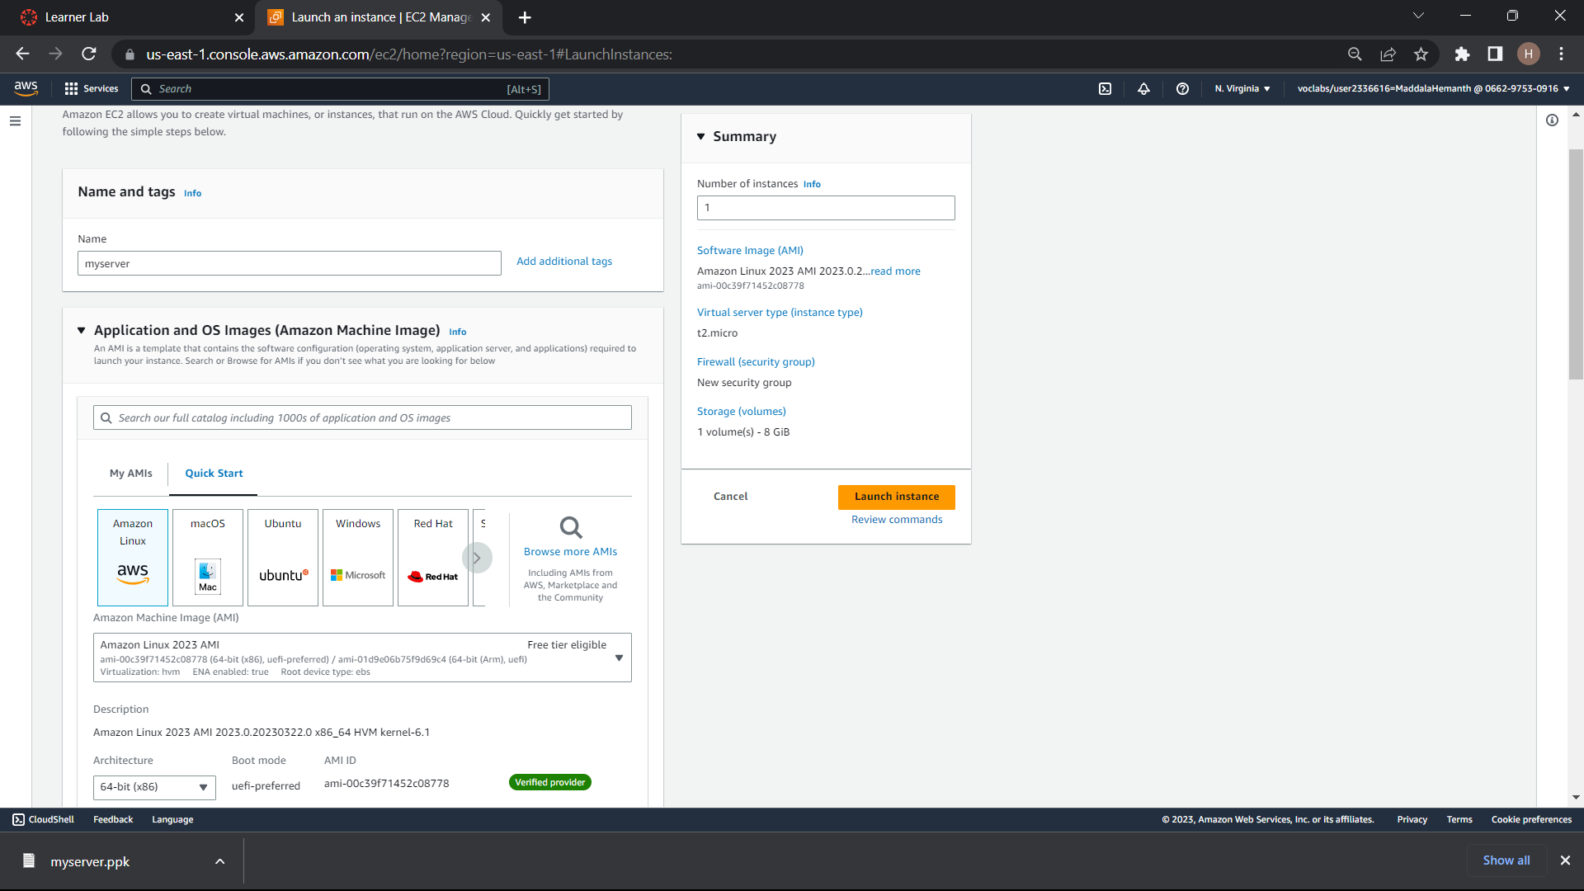

Slide 5
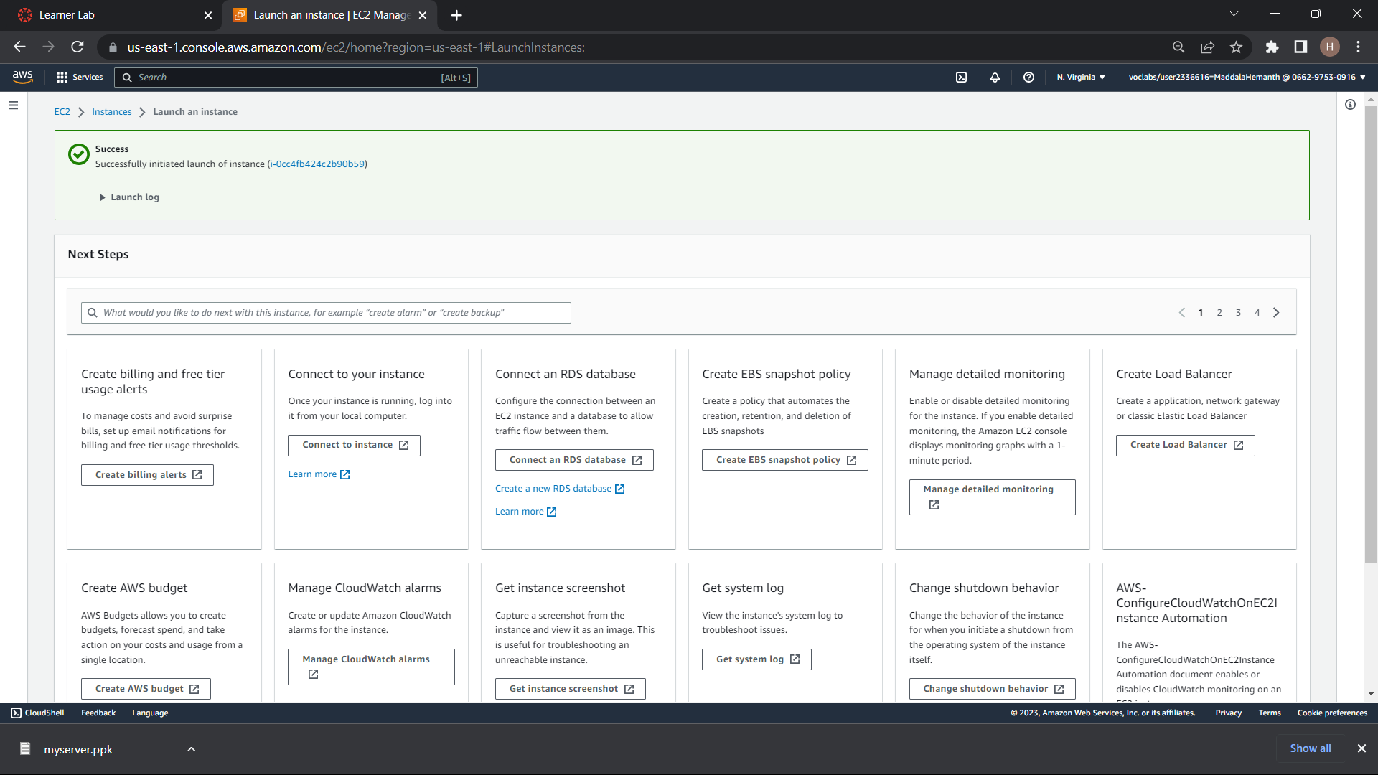
Step5:click launch instance

Slide 6
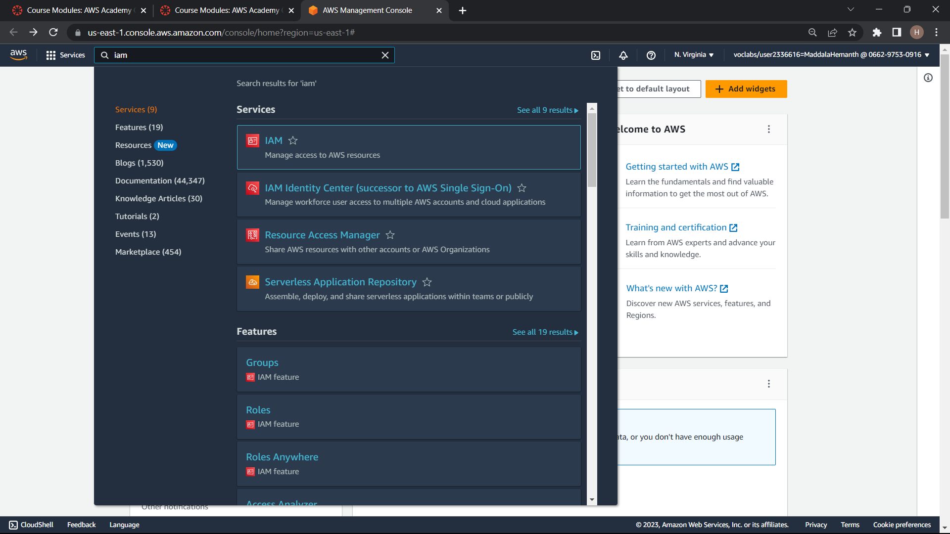
AWS IAM
Step1:Log in to your aws account and navigate to the IAM service

Slide 7
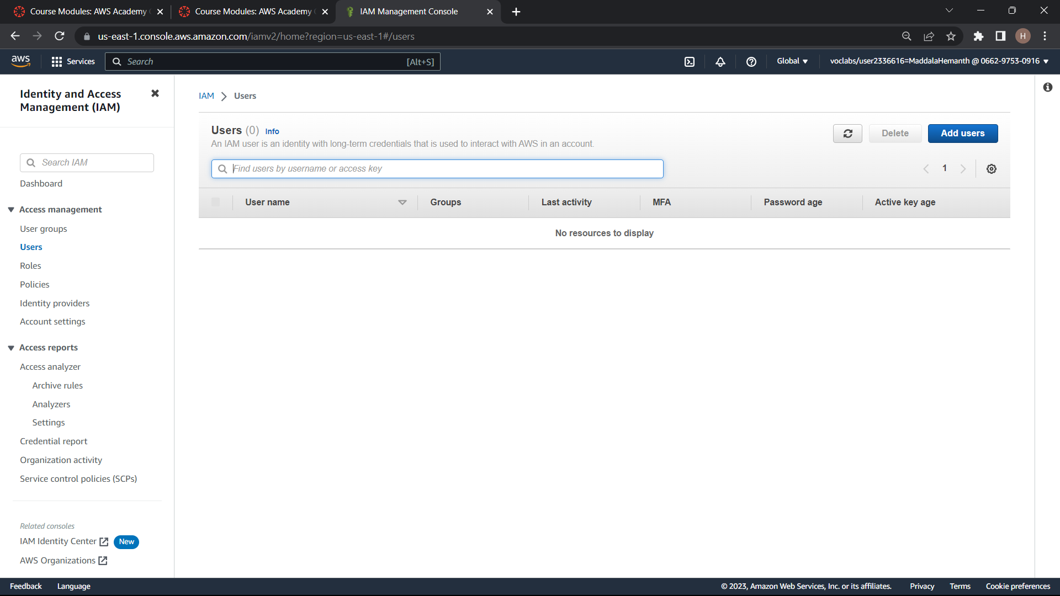
Step2:create a new IAM user by selecting users in the left navigation menu and click the add user button and click on next next and click create user

Slide 8
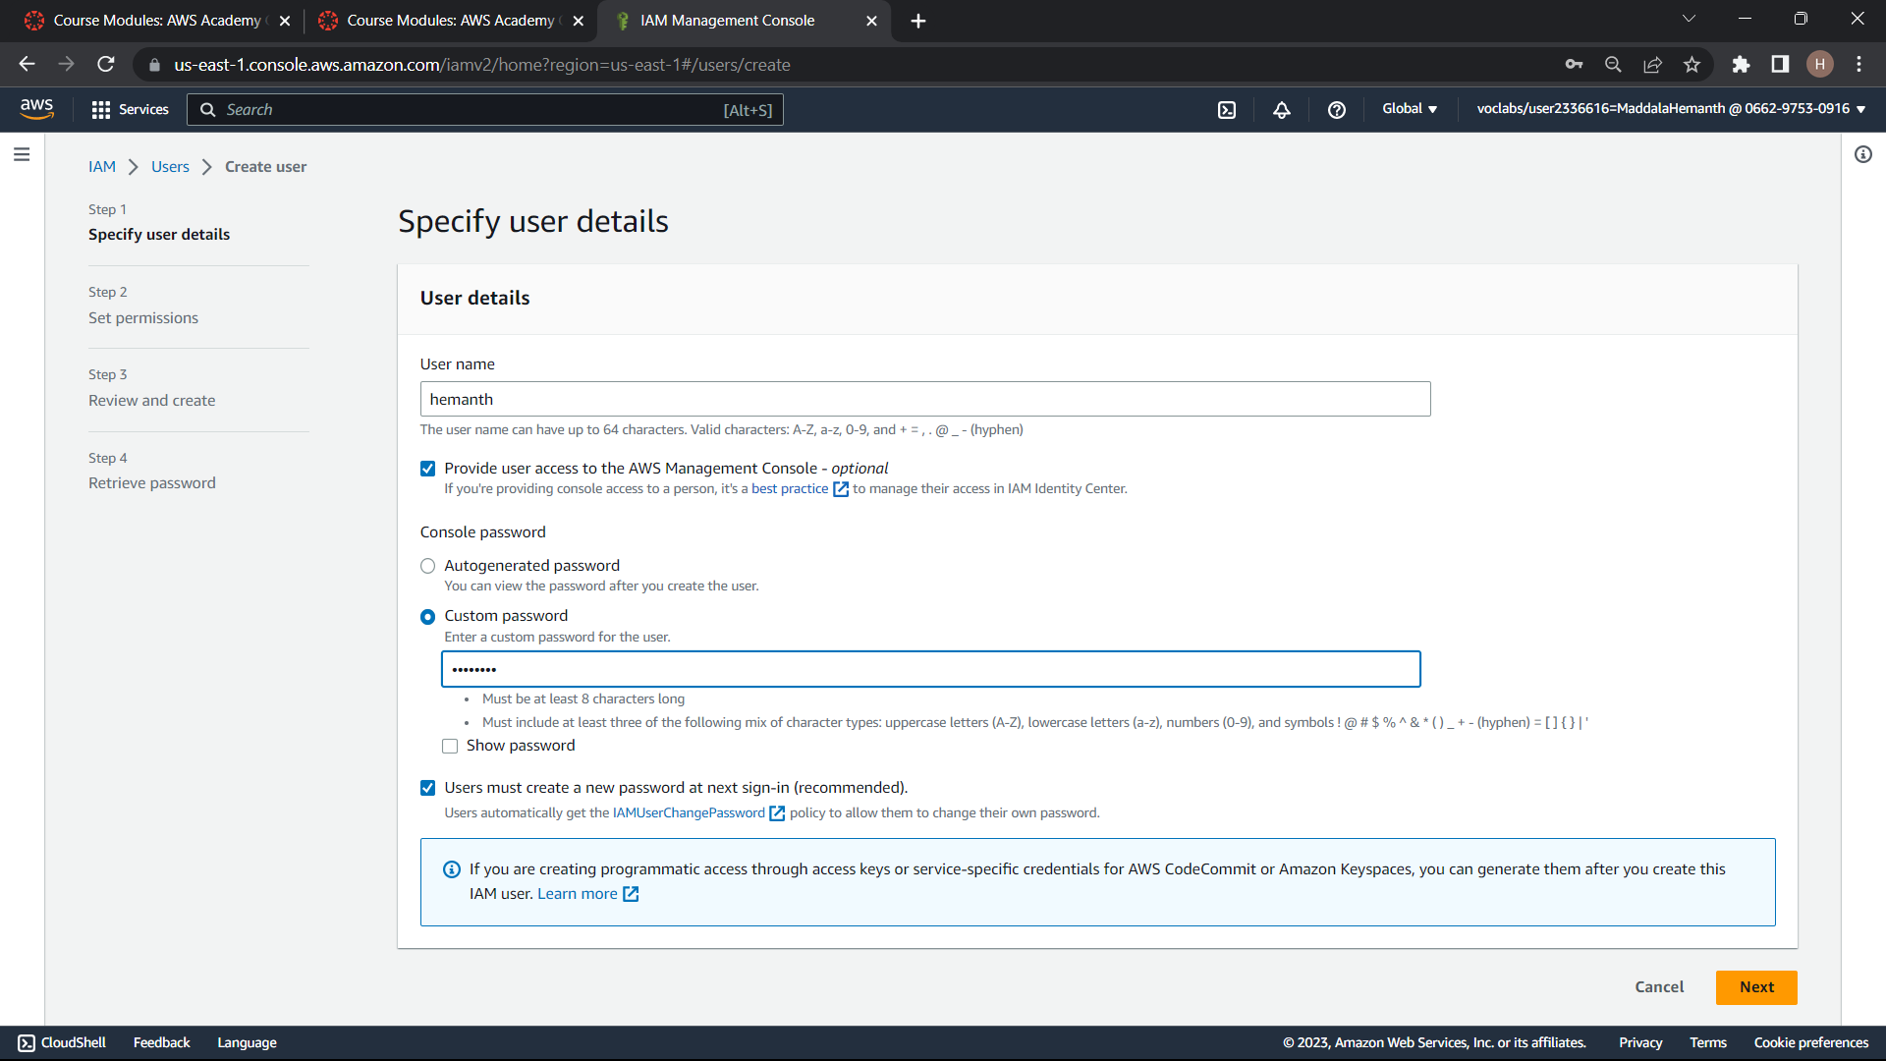

Slide 9
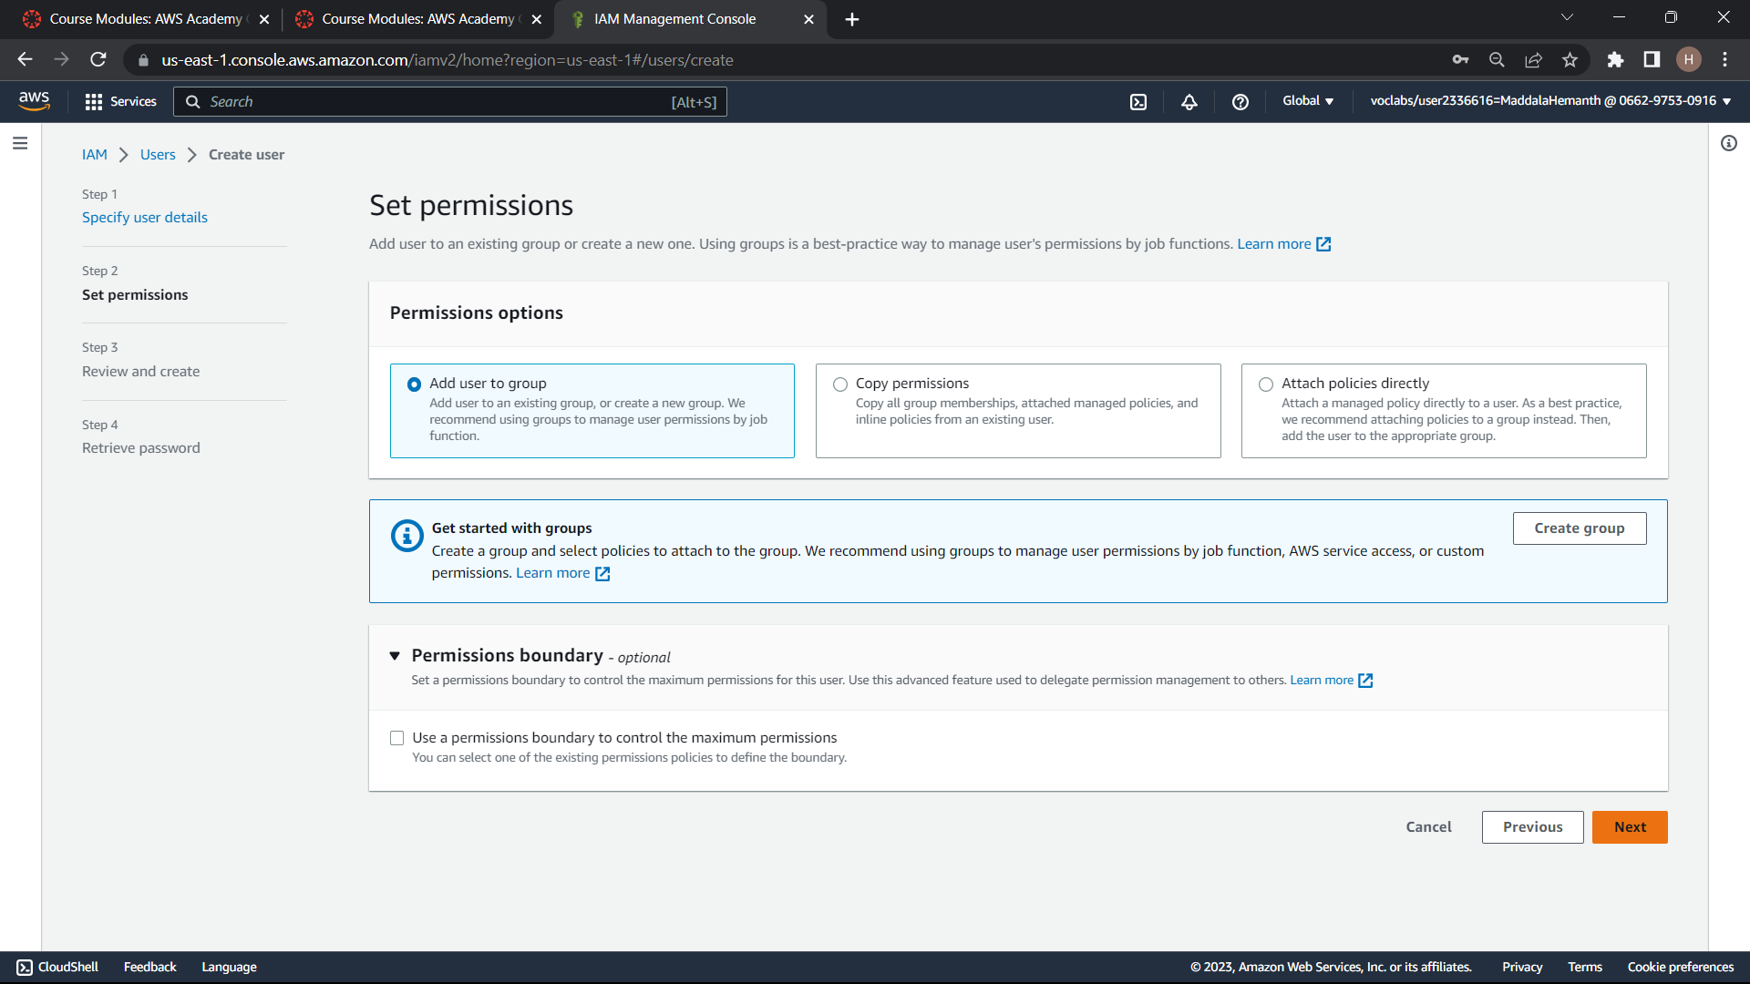

Slide 10
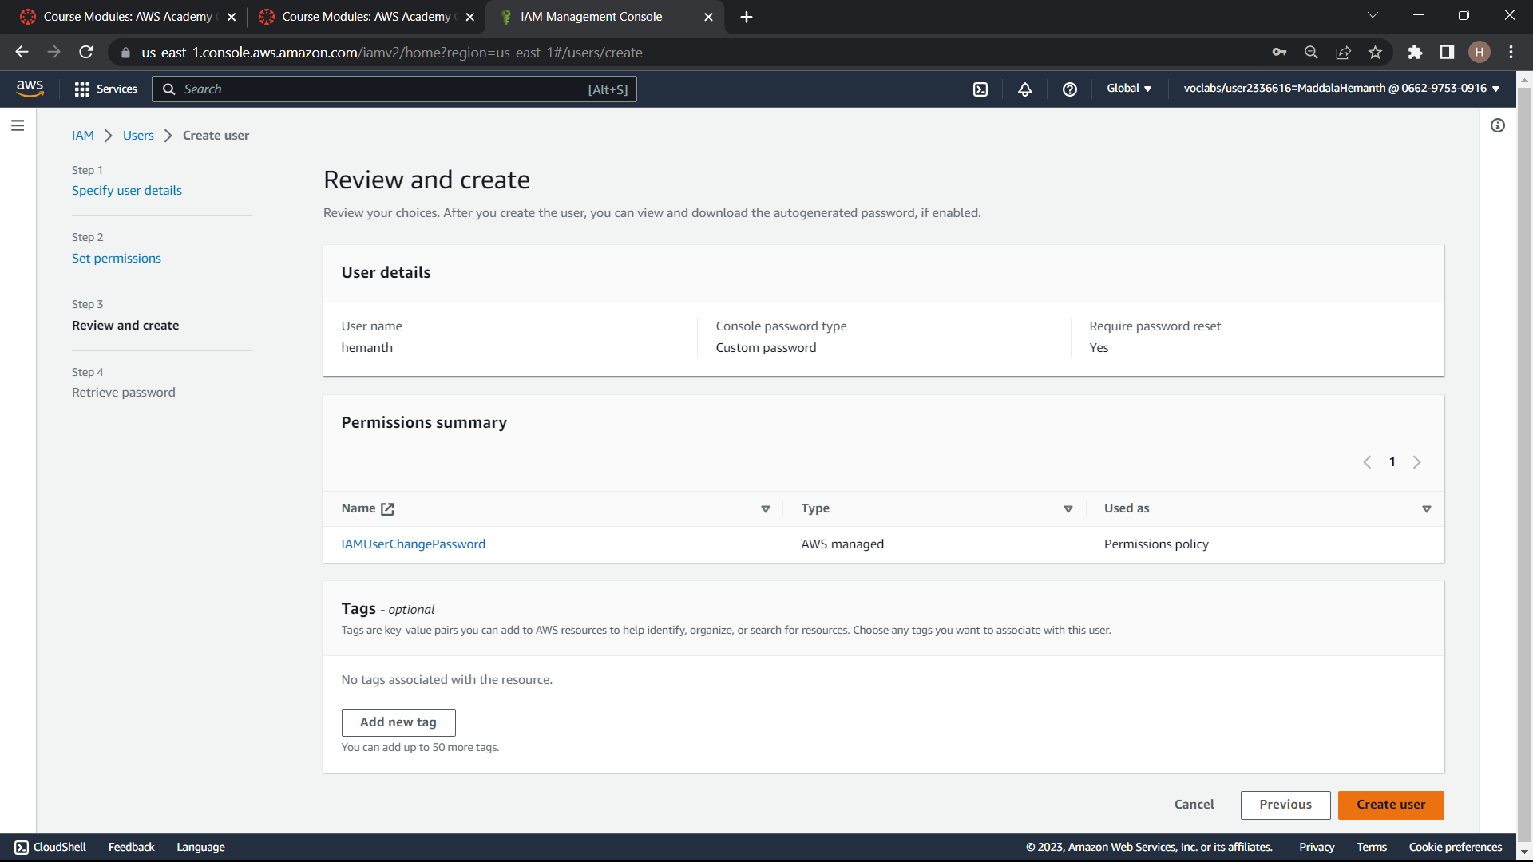

Slide 11
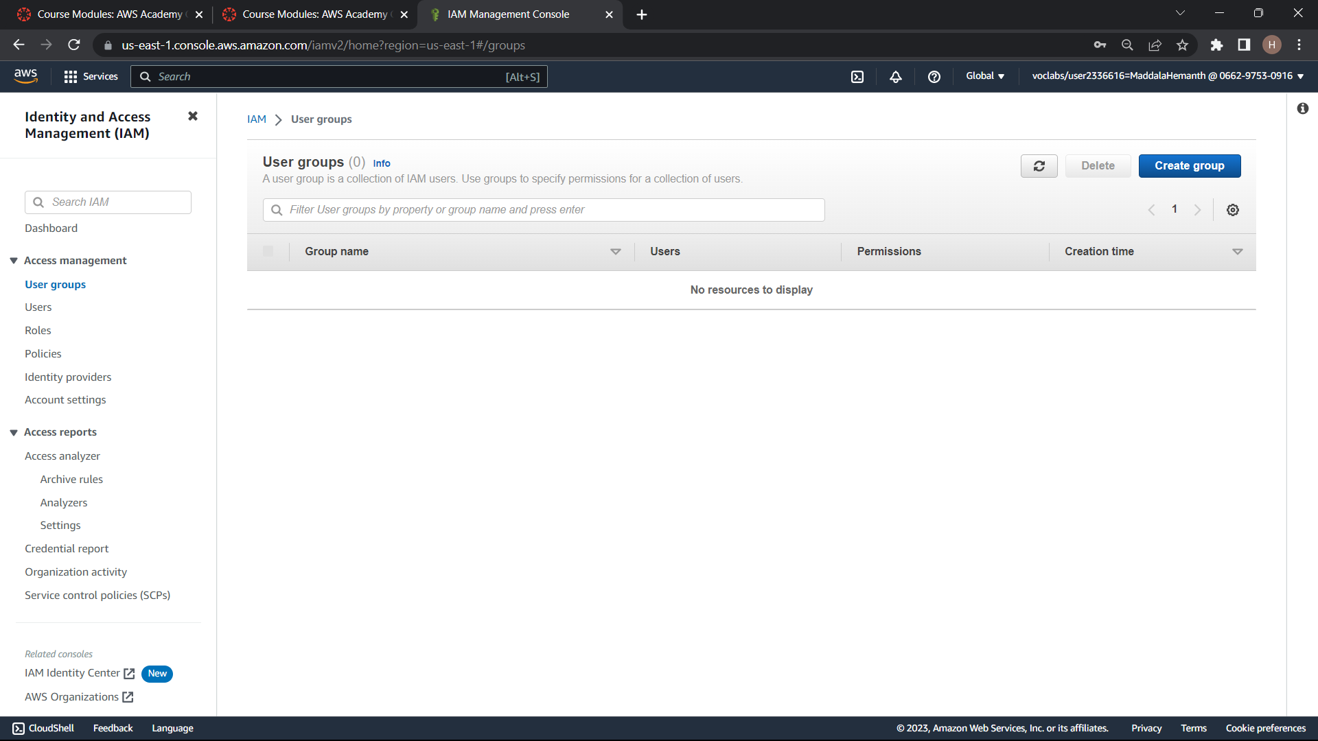

Slide 12
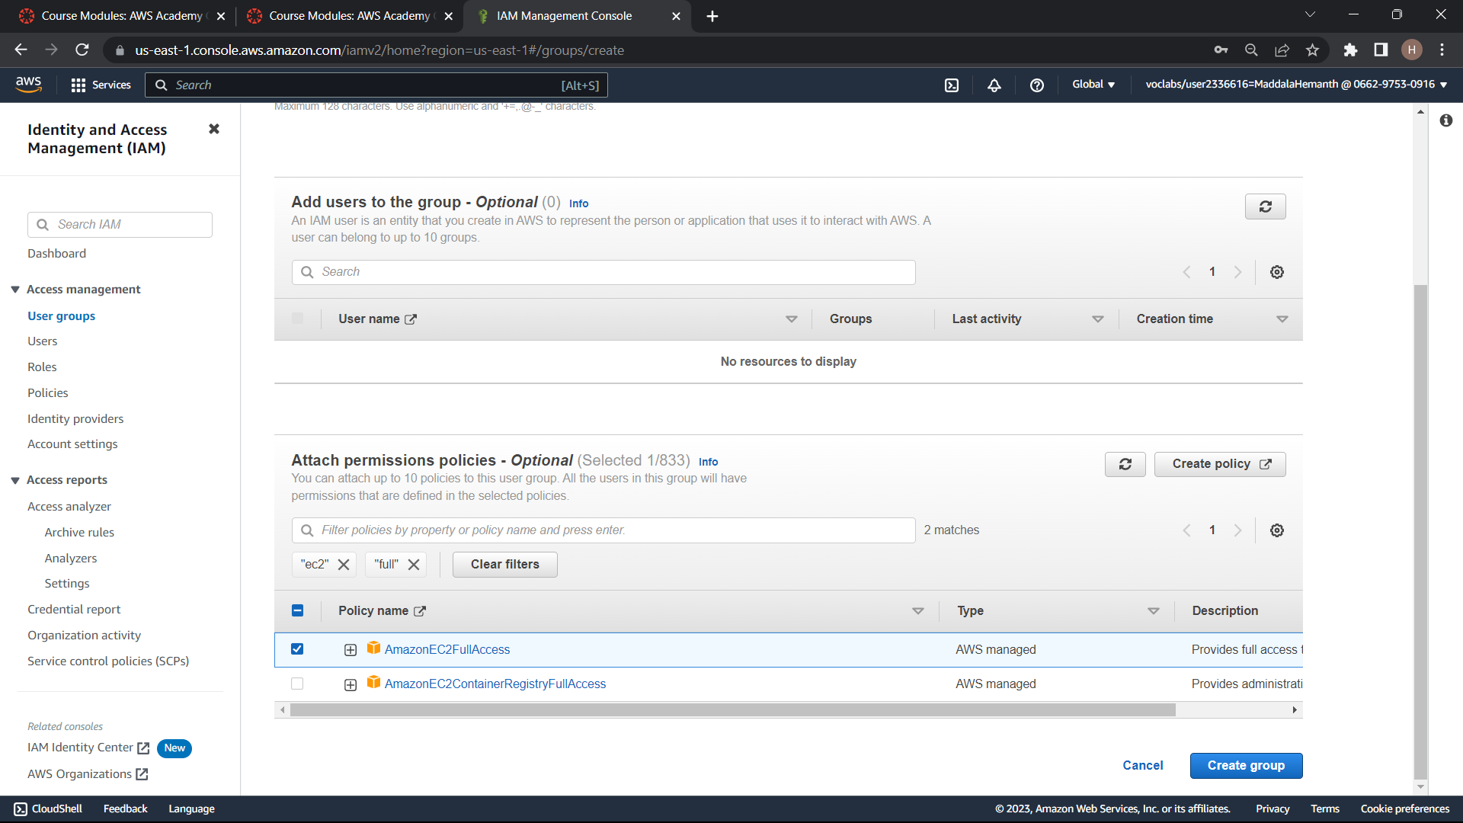

Slide 13
Step4:Add the IAM user to the IAM group by selecting the group and clicking on the add users to the group button. select the user that you have created in step2
Step5:Give a service that you want to give the user access to and select the permissions that you want to grant
Step6:Test the IAM users access by login in to the account by using the credentials

Slide 14
Create an alarm
Step1:Login into your aws account
Step2:Navigate to the CloudWatch service by typing CloudWatch in the search bar and selecting the CloudWatch service
Step3:click on the alarms option in the left navigation
Step4:click on the create alarm button in the billing and set the currency to rupees and choose further options and click next

Slide 15
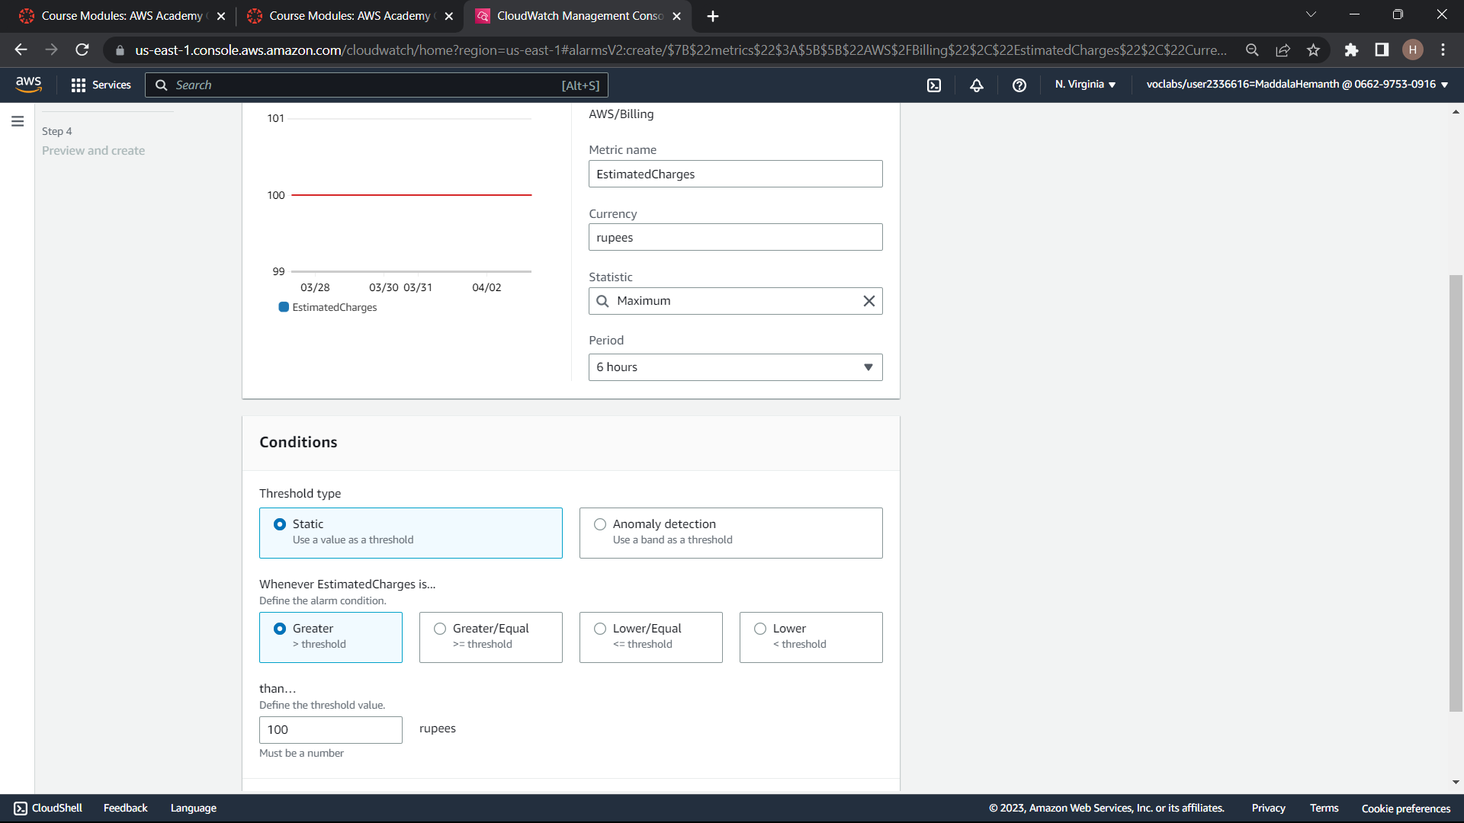
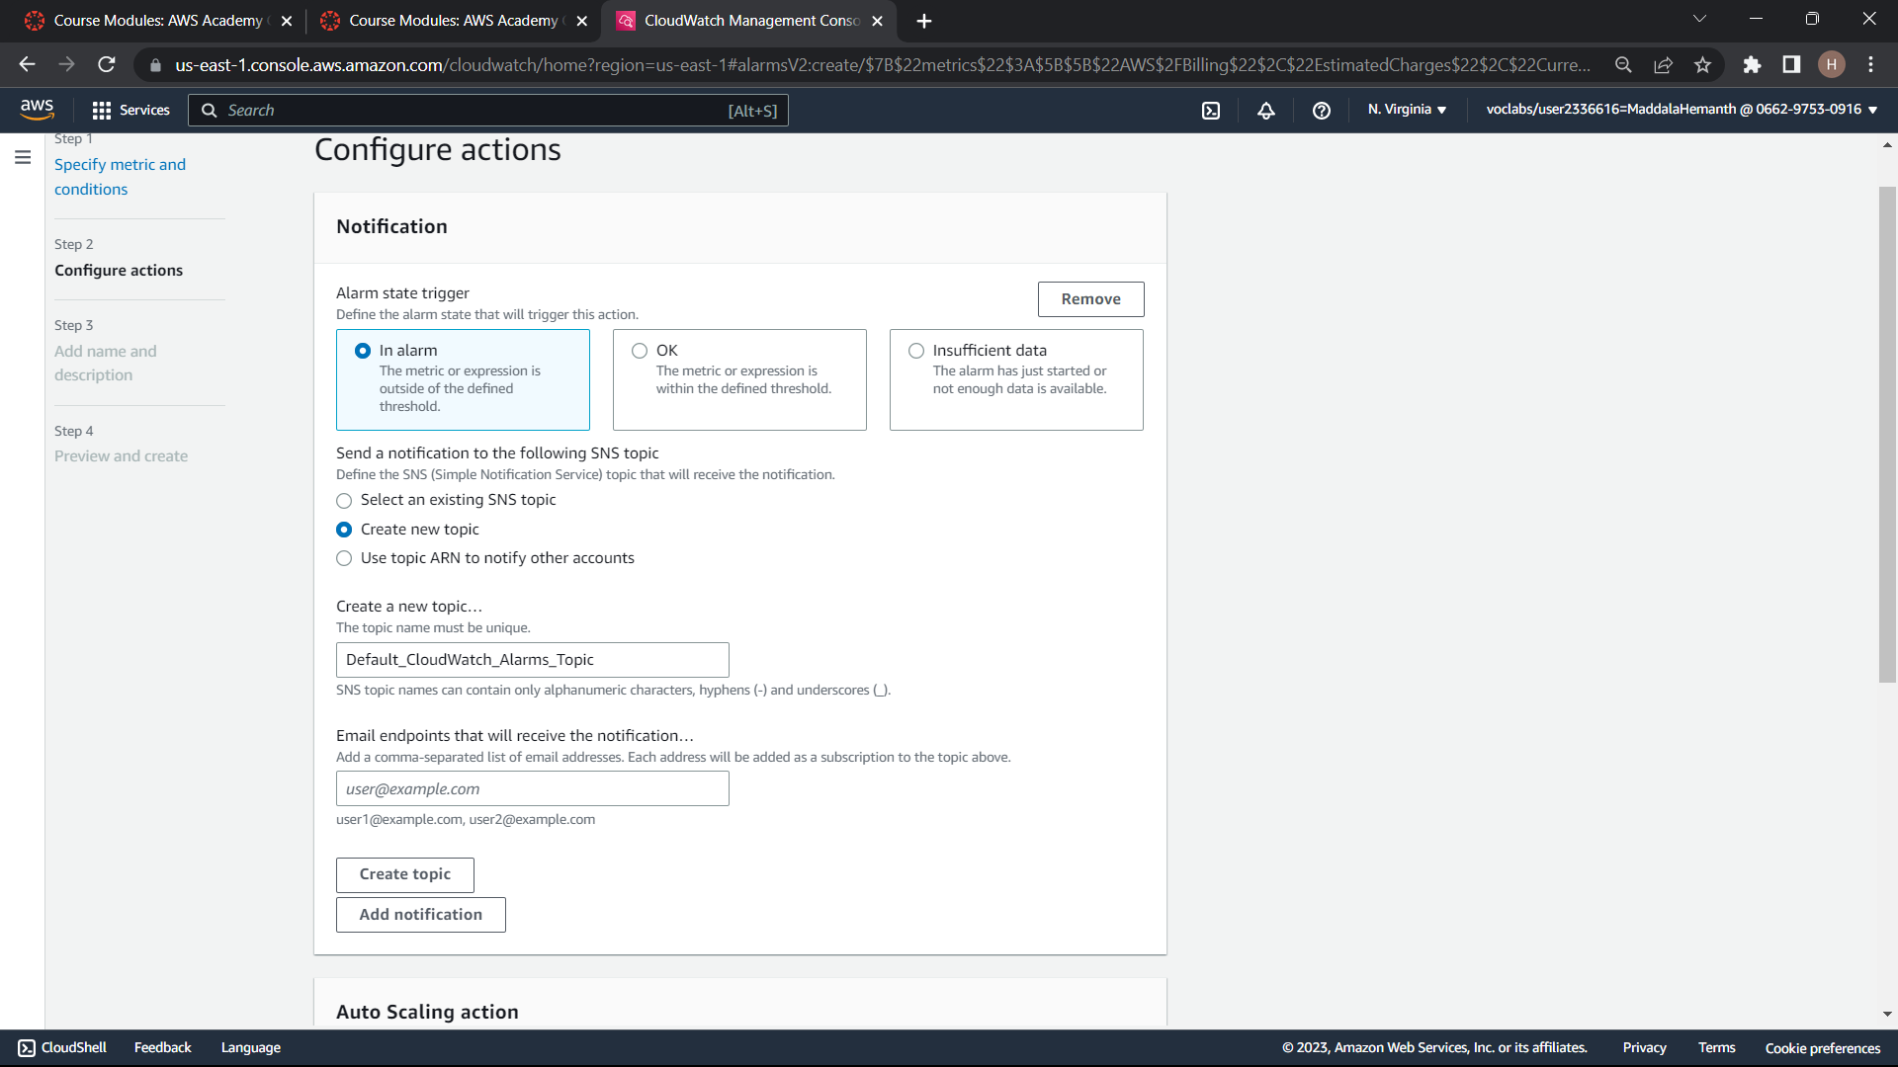
Step5:Name your alarm and add a description to help identify the alarm purpose

Slide 16
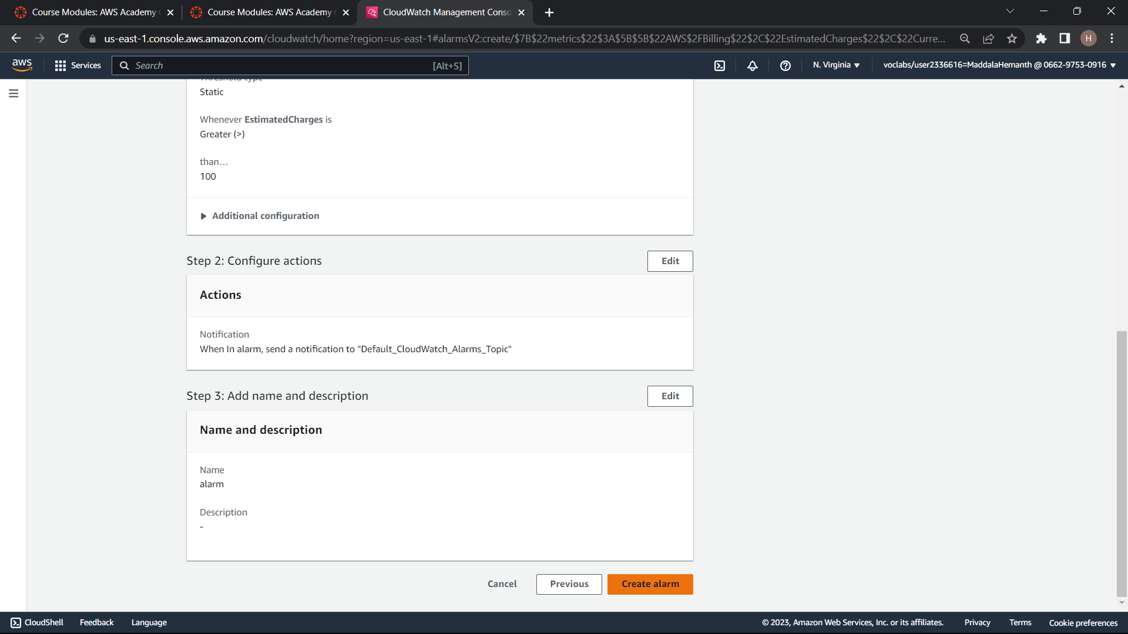
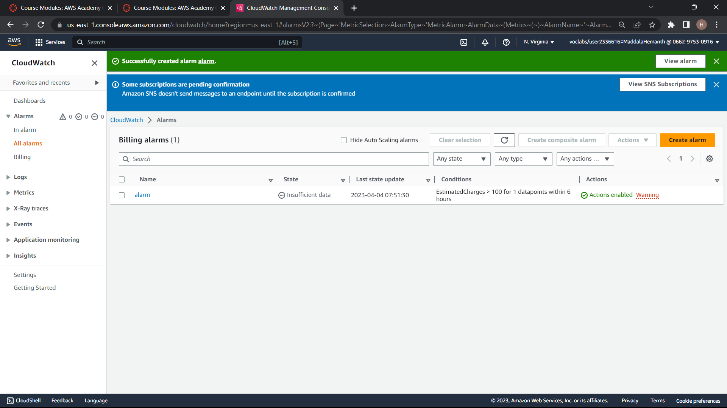

Slide 17
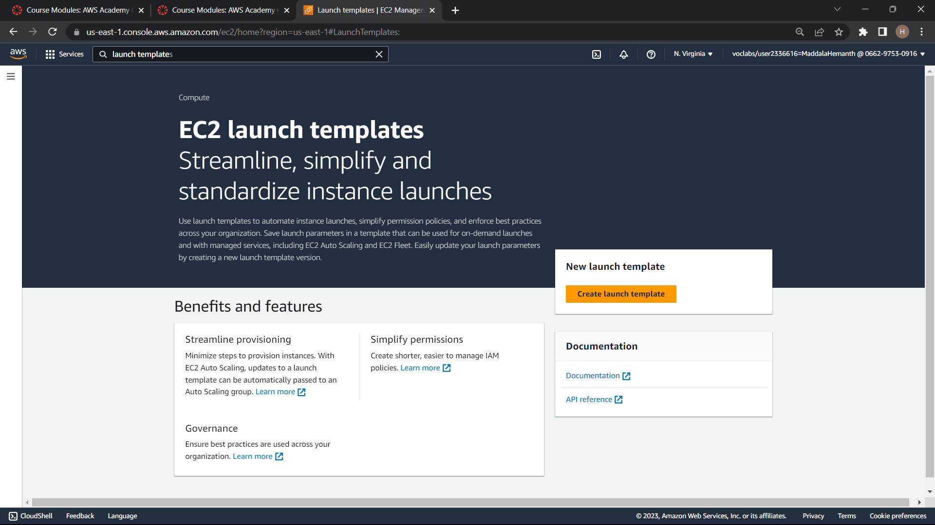
LAUNCH TEMPLATE

Slide 18
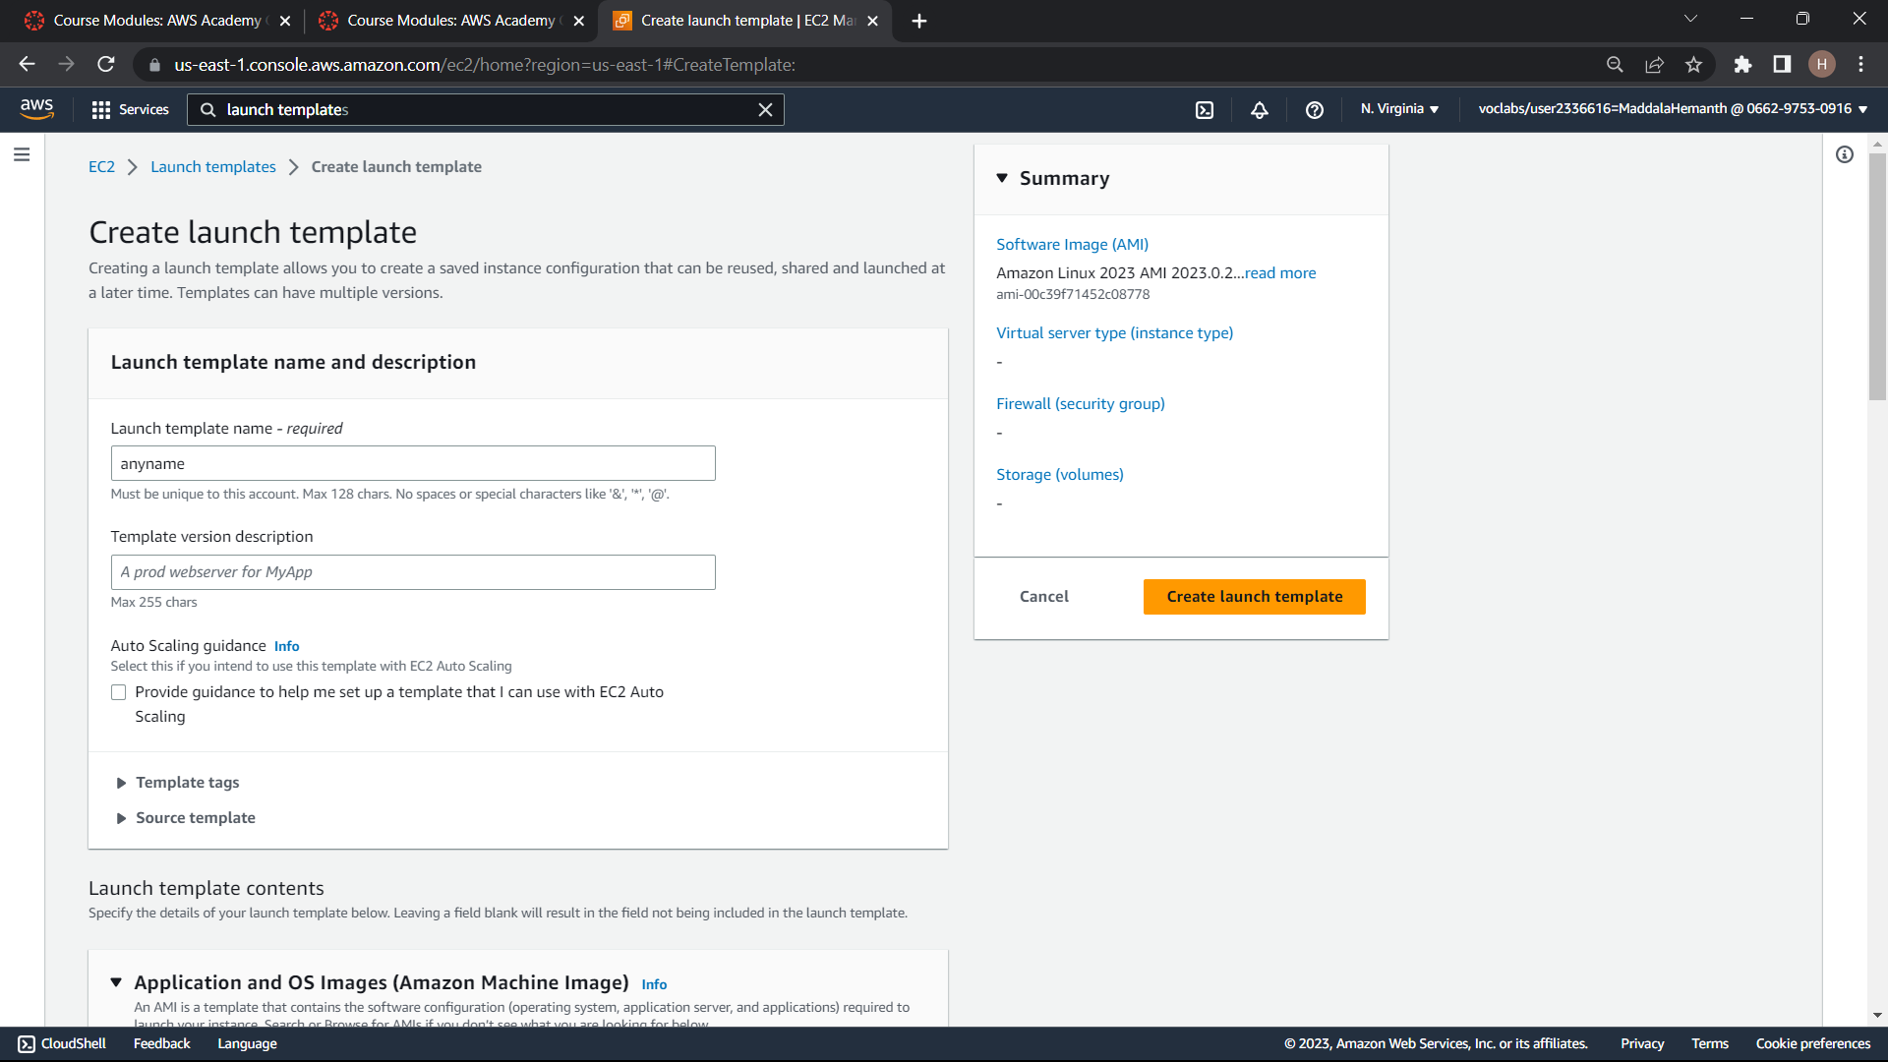

Slide 19
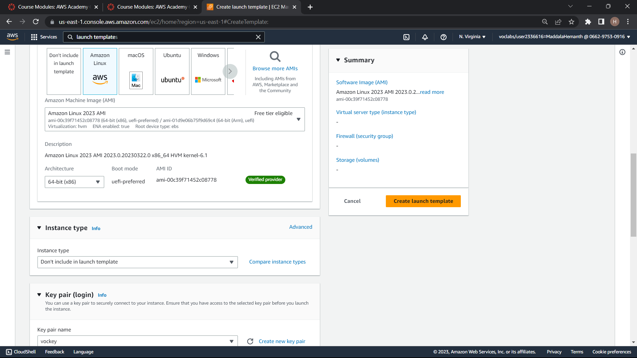

Slide 20
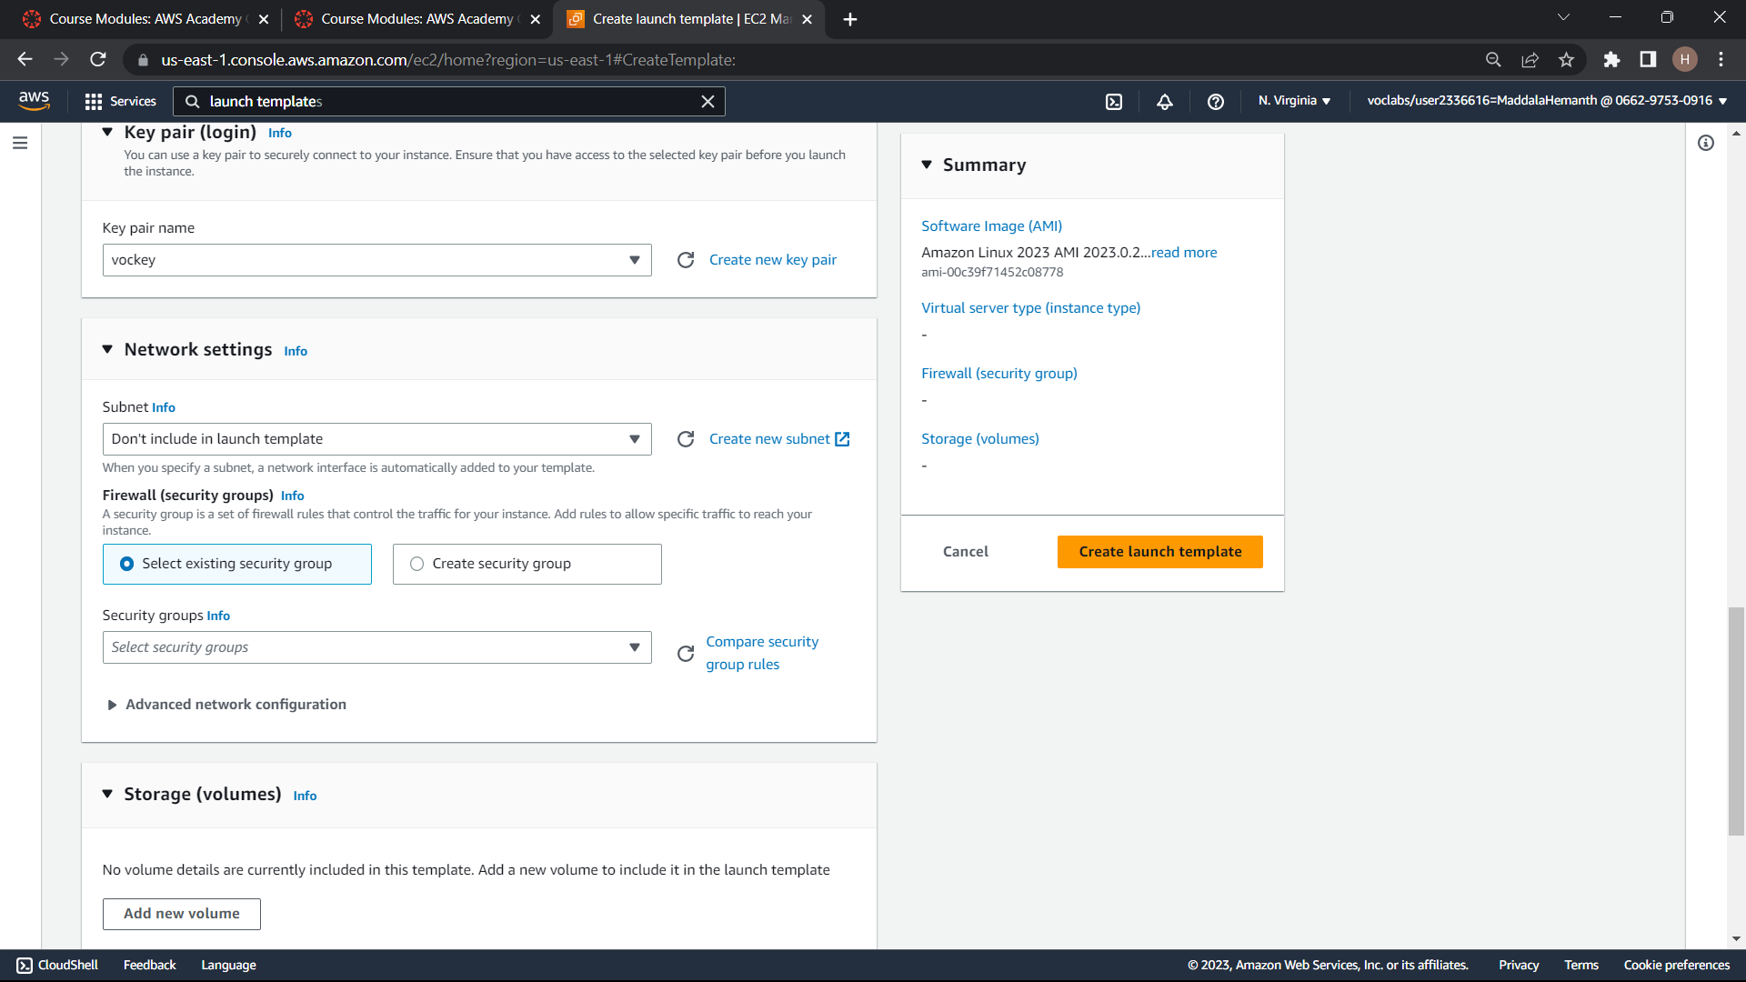

Slide 21
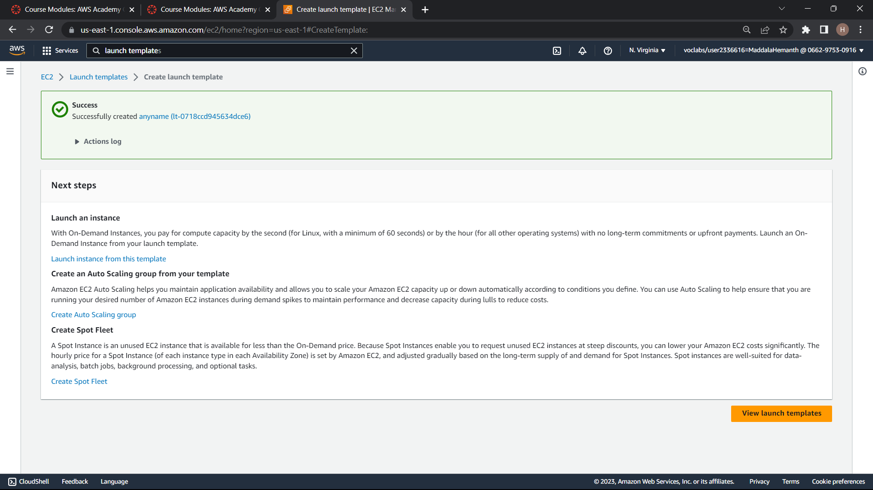

Slide 22
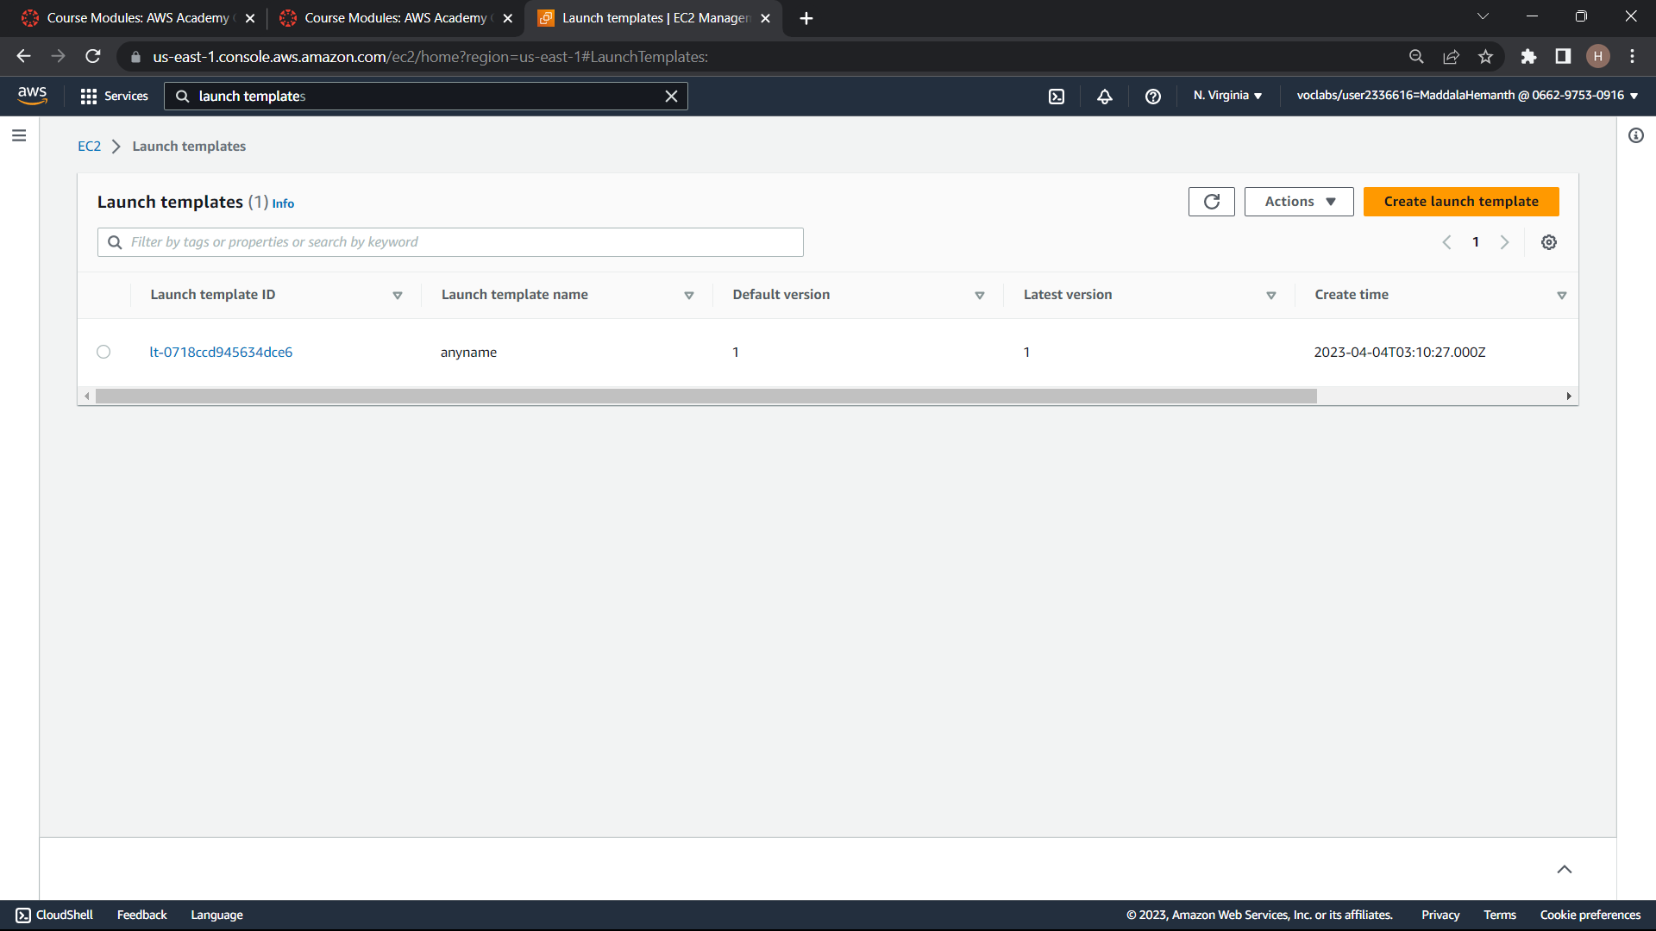

Slide 23
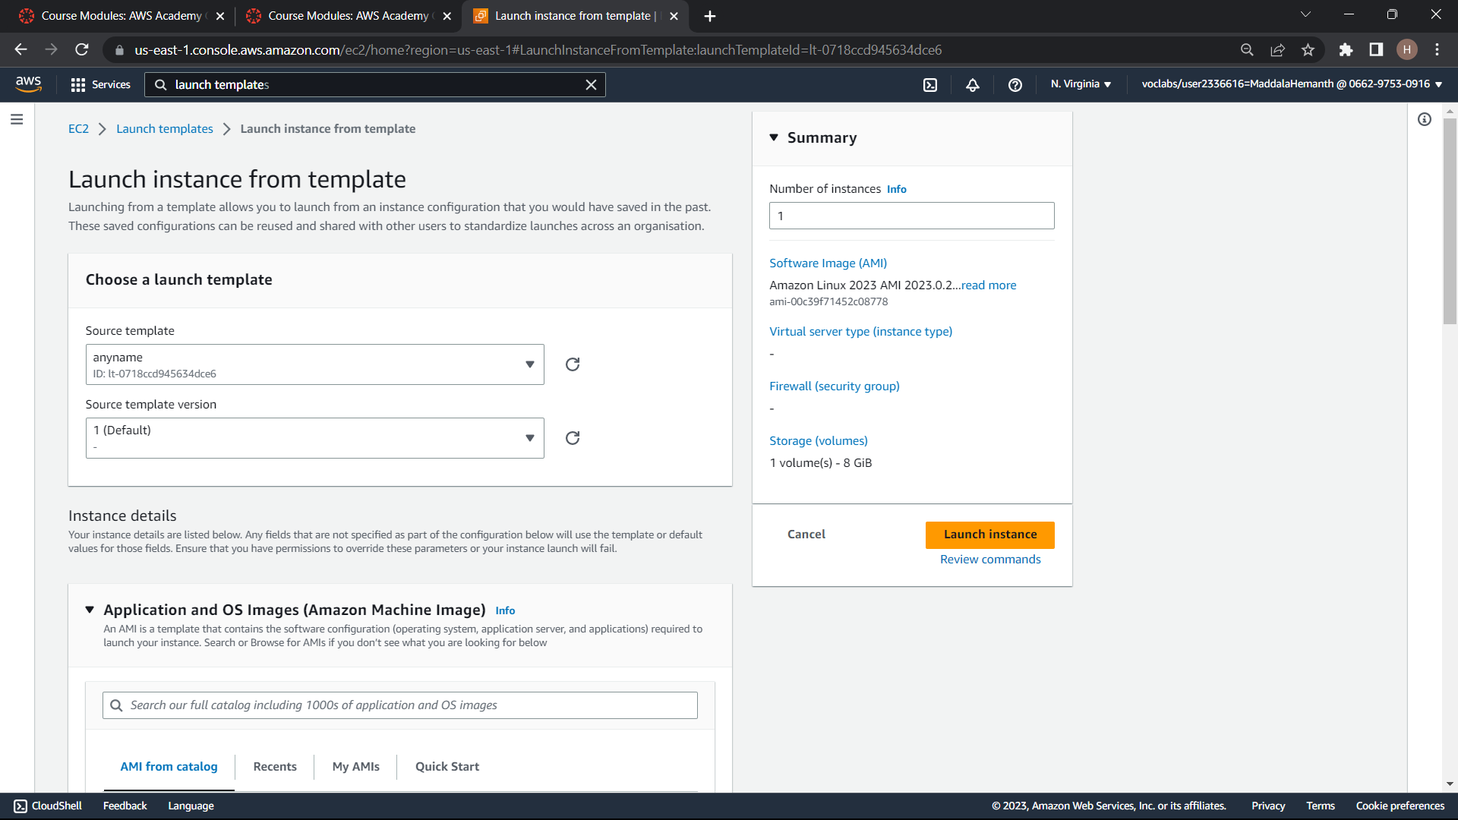

Slide 24
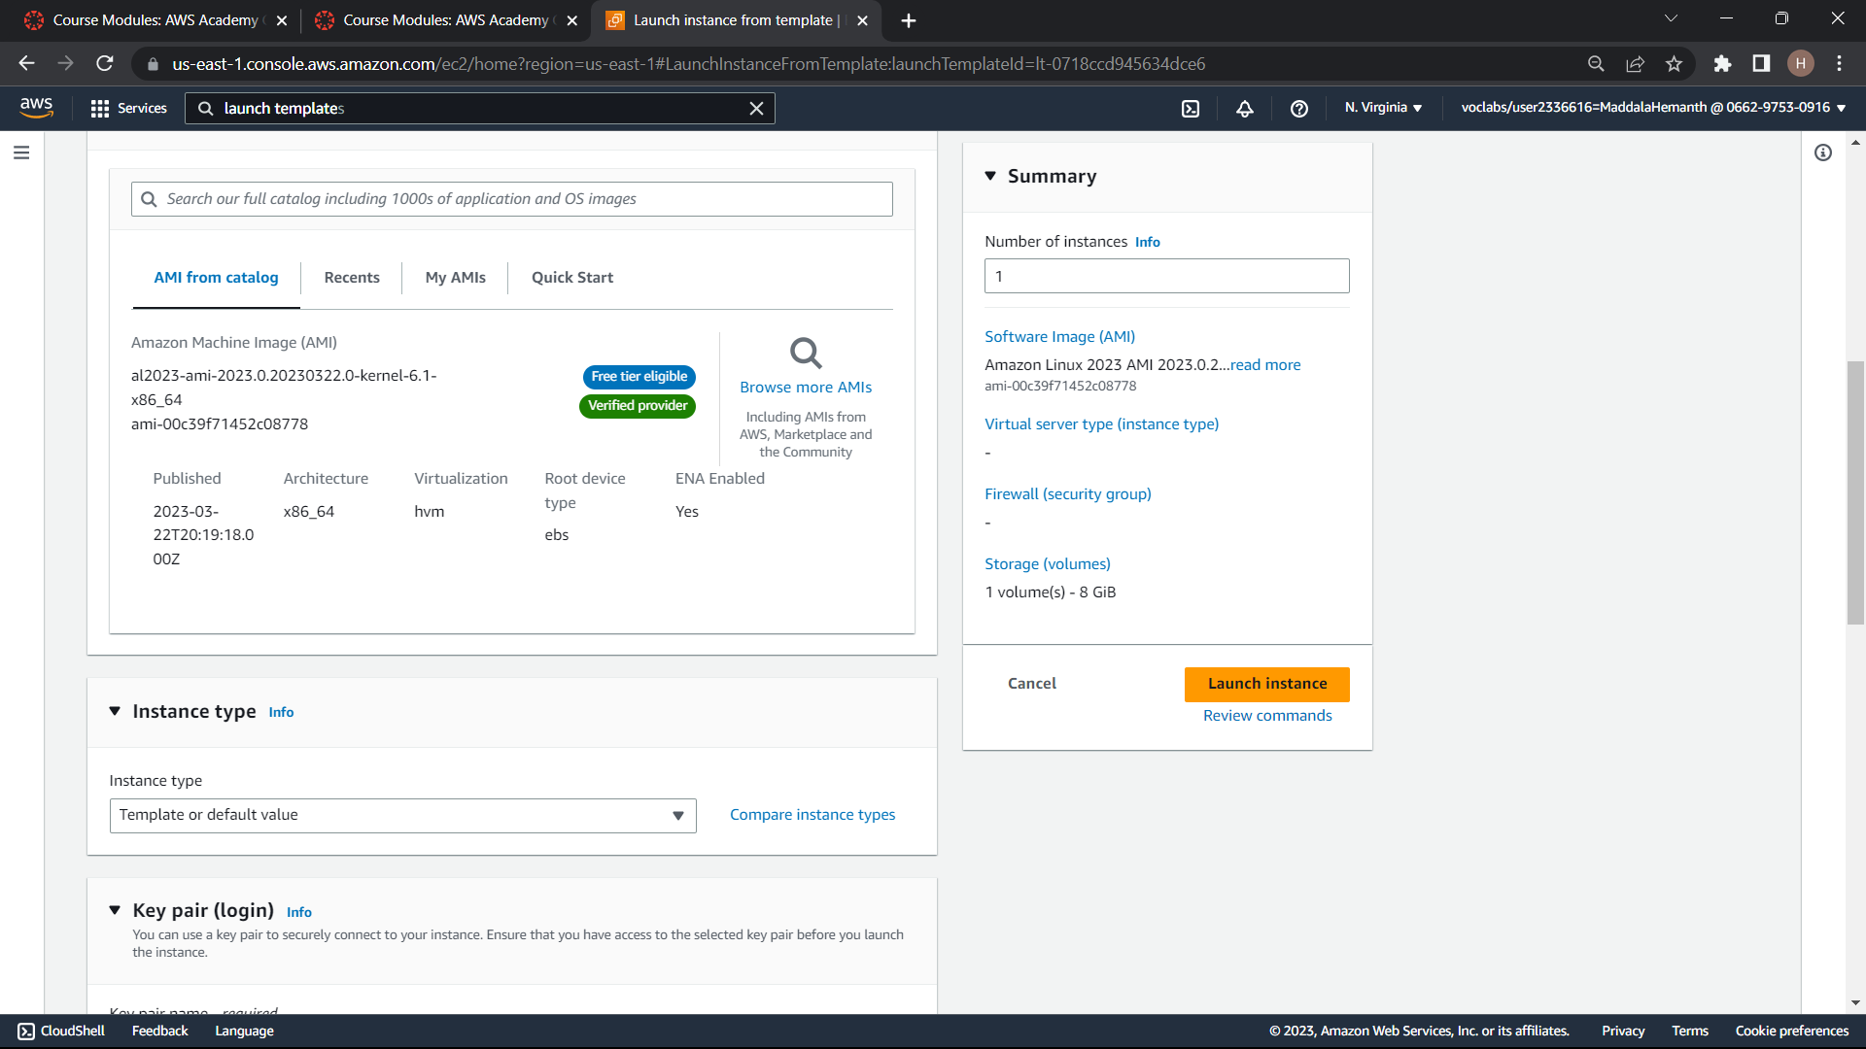

Slide 25
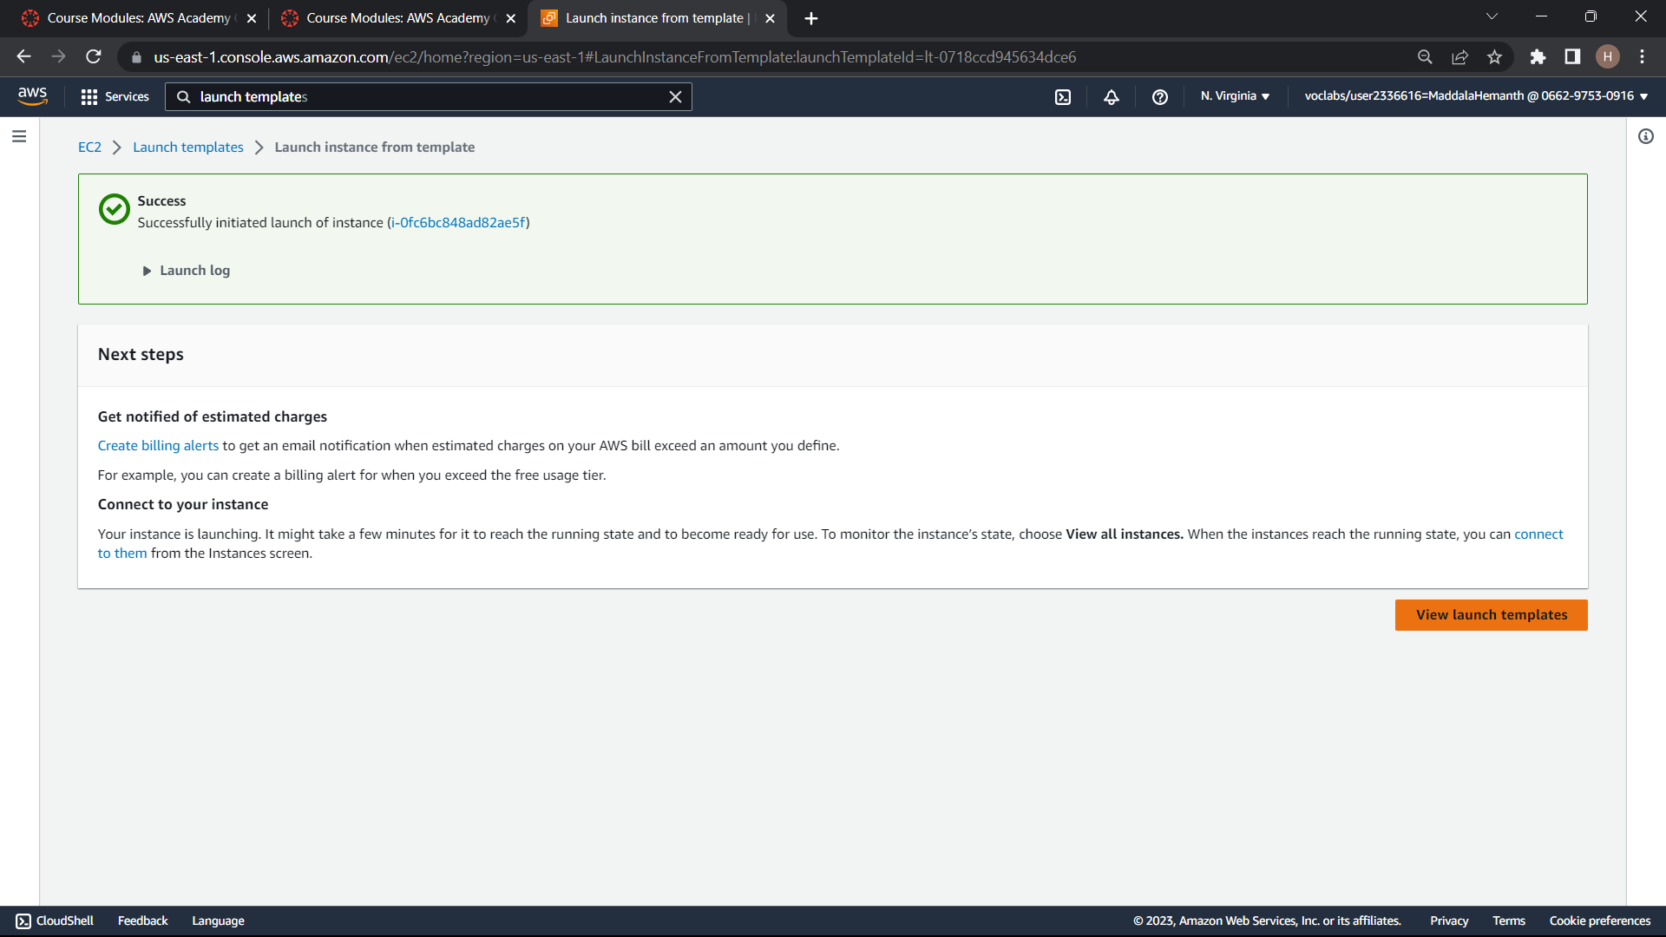

Slide 26
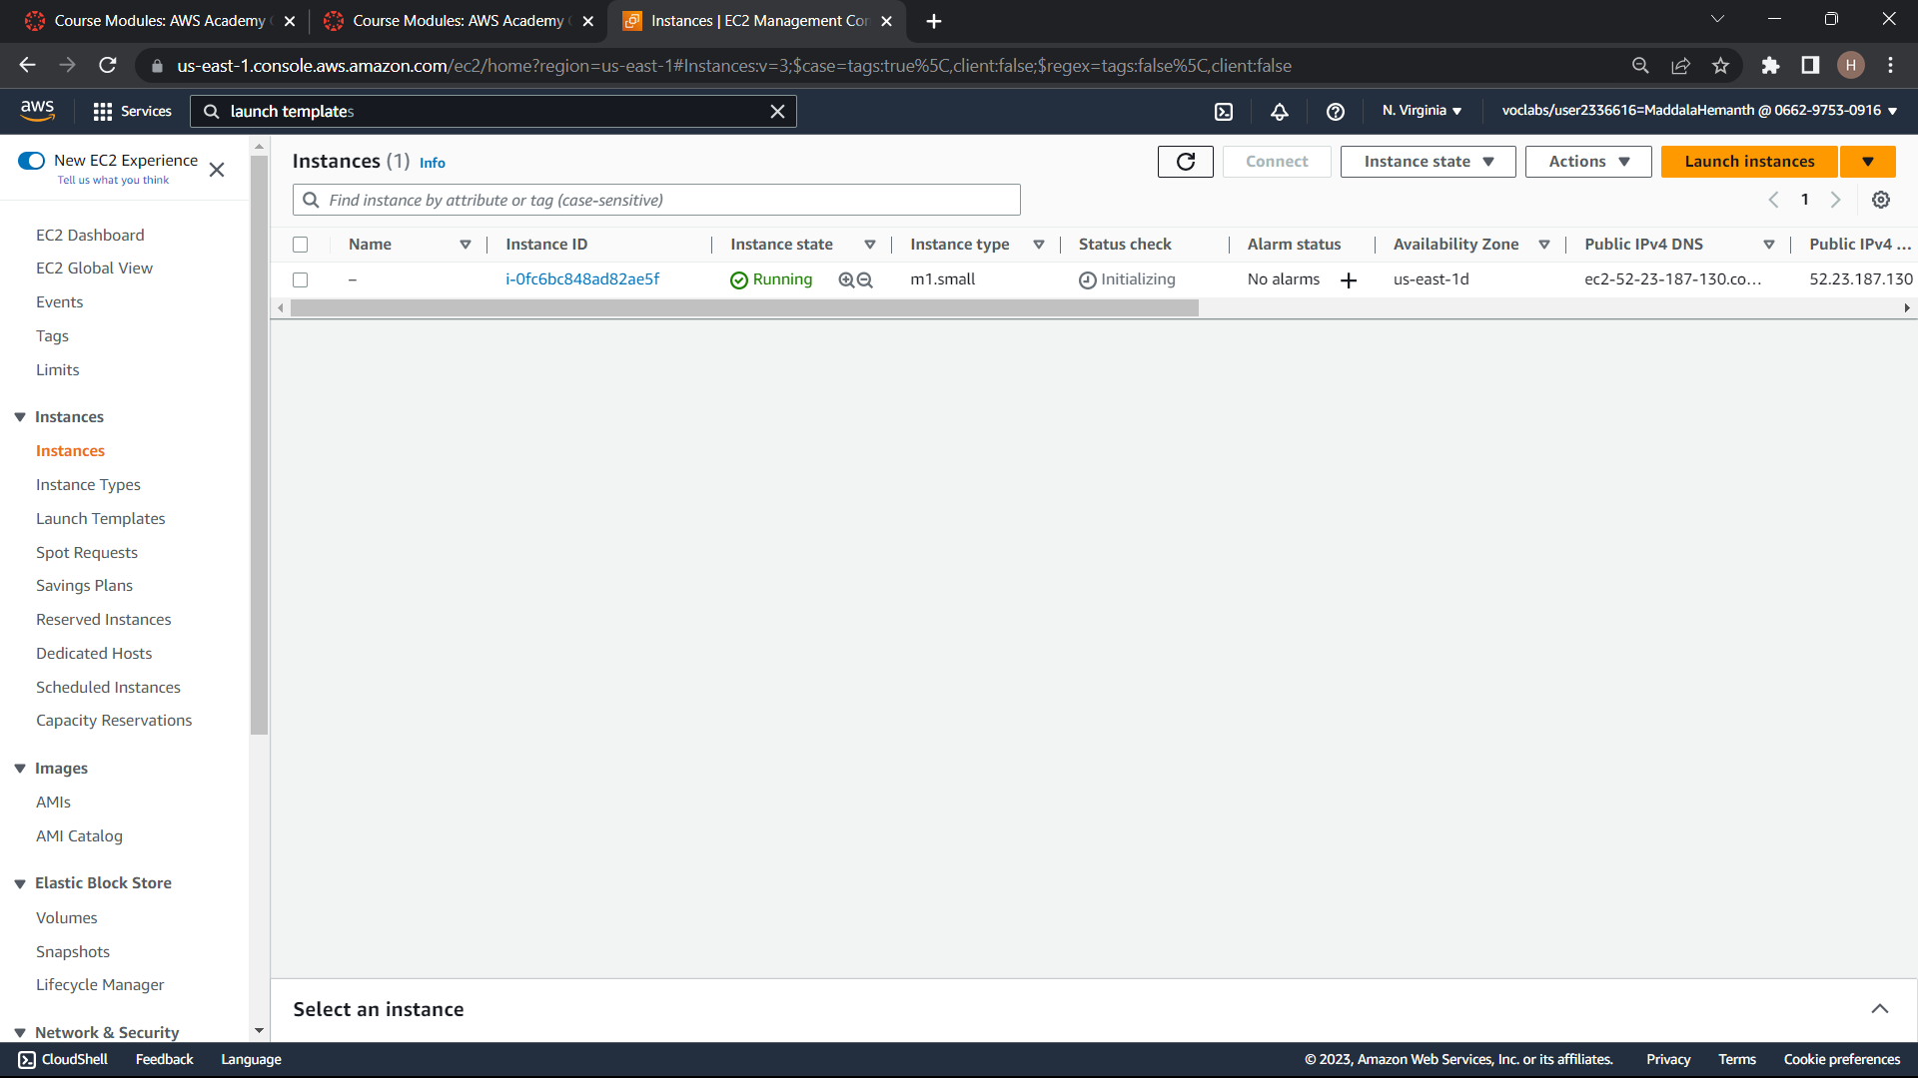

Slide 27
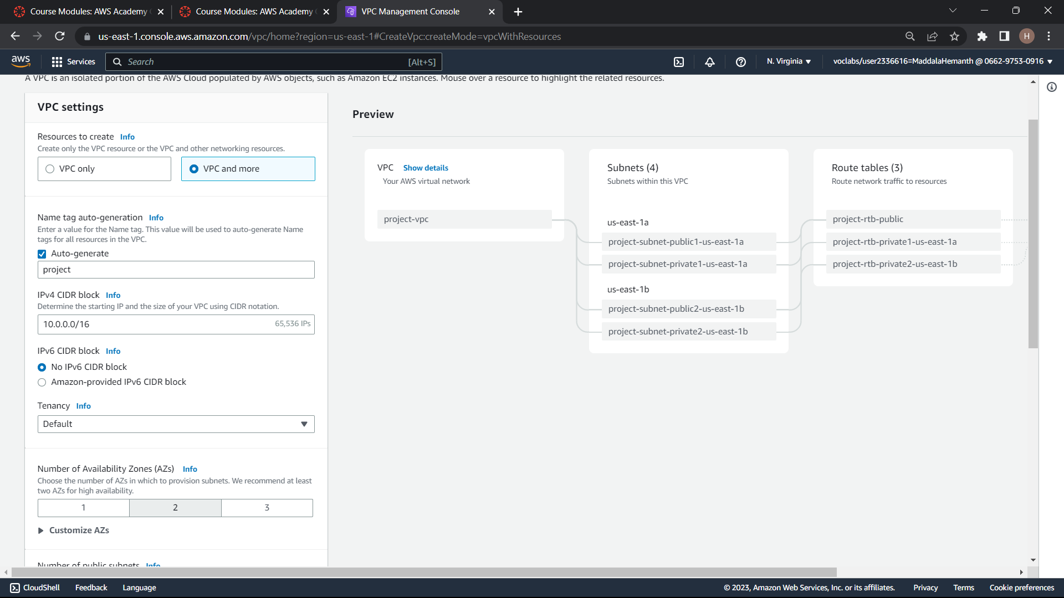
VPC CREATION

Slide 28
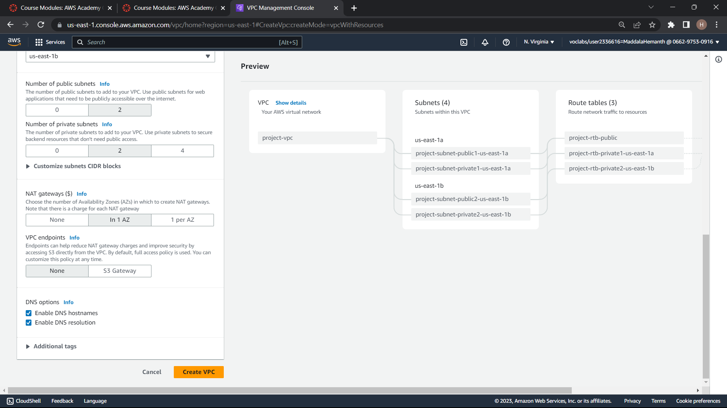

Slide 29
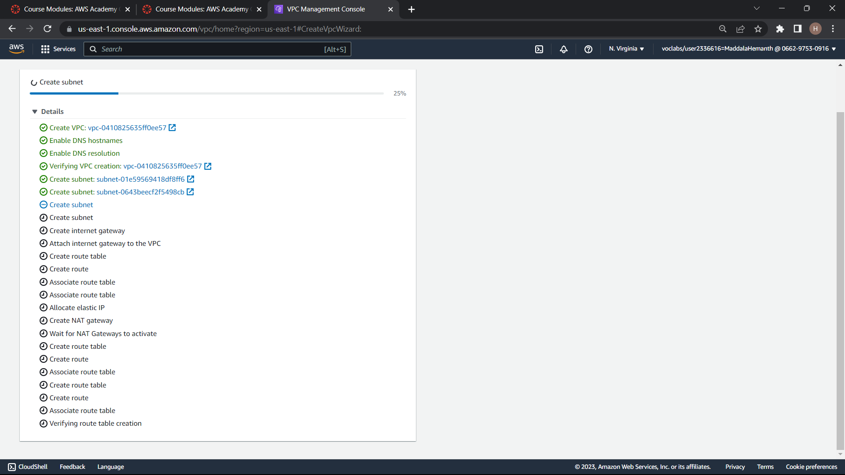

Slide 30
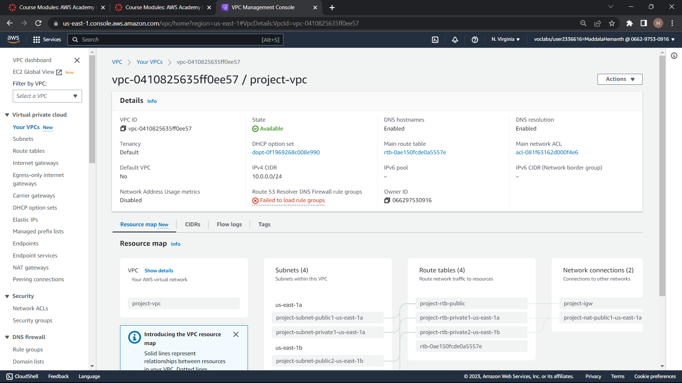

Slide 31
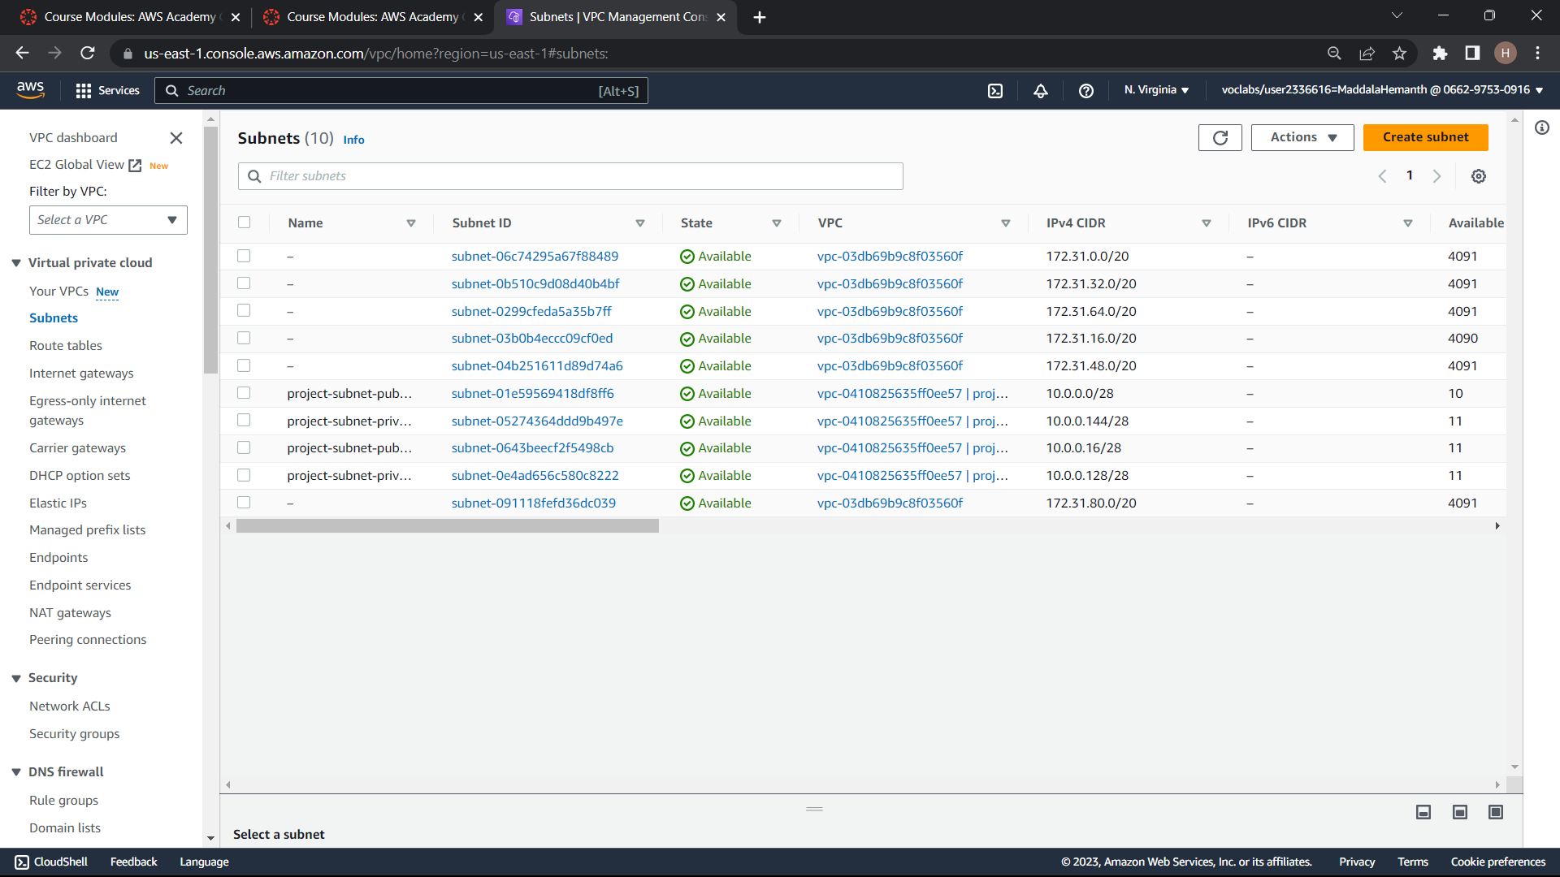

Slide 32
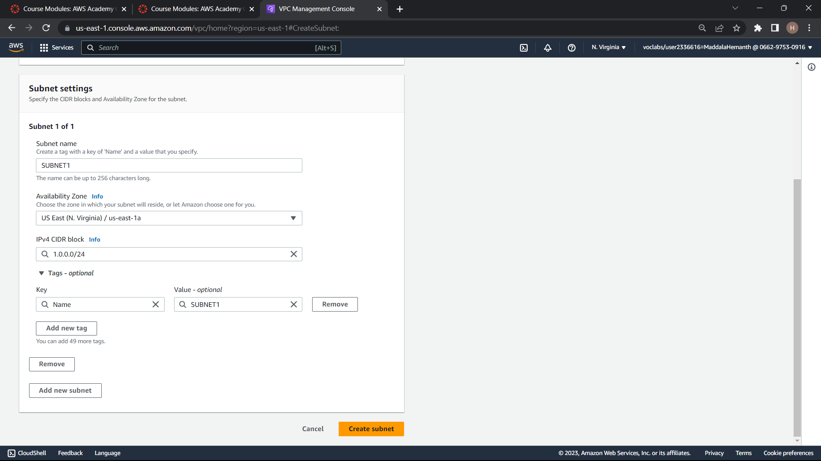

Slide 33
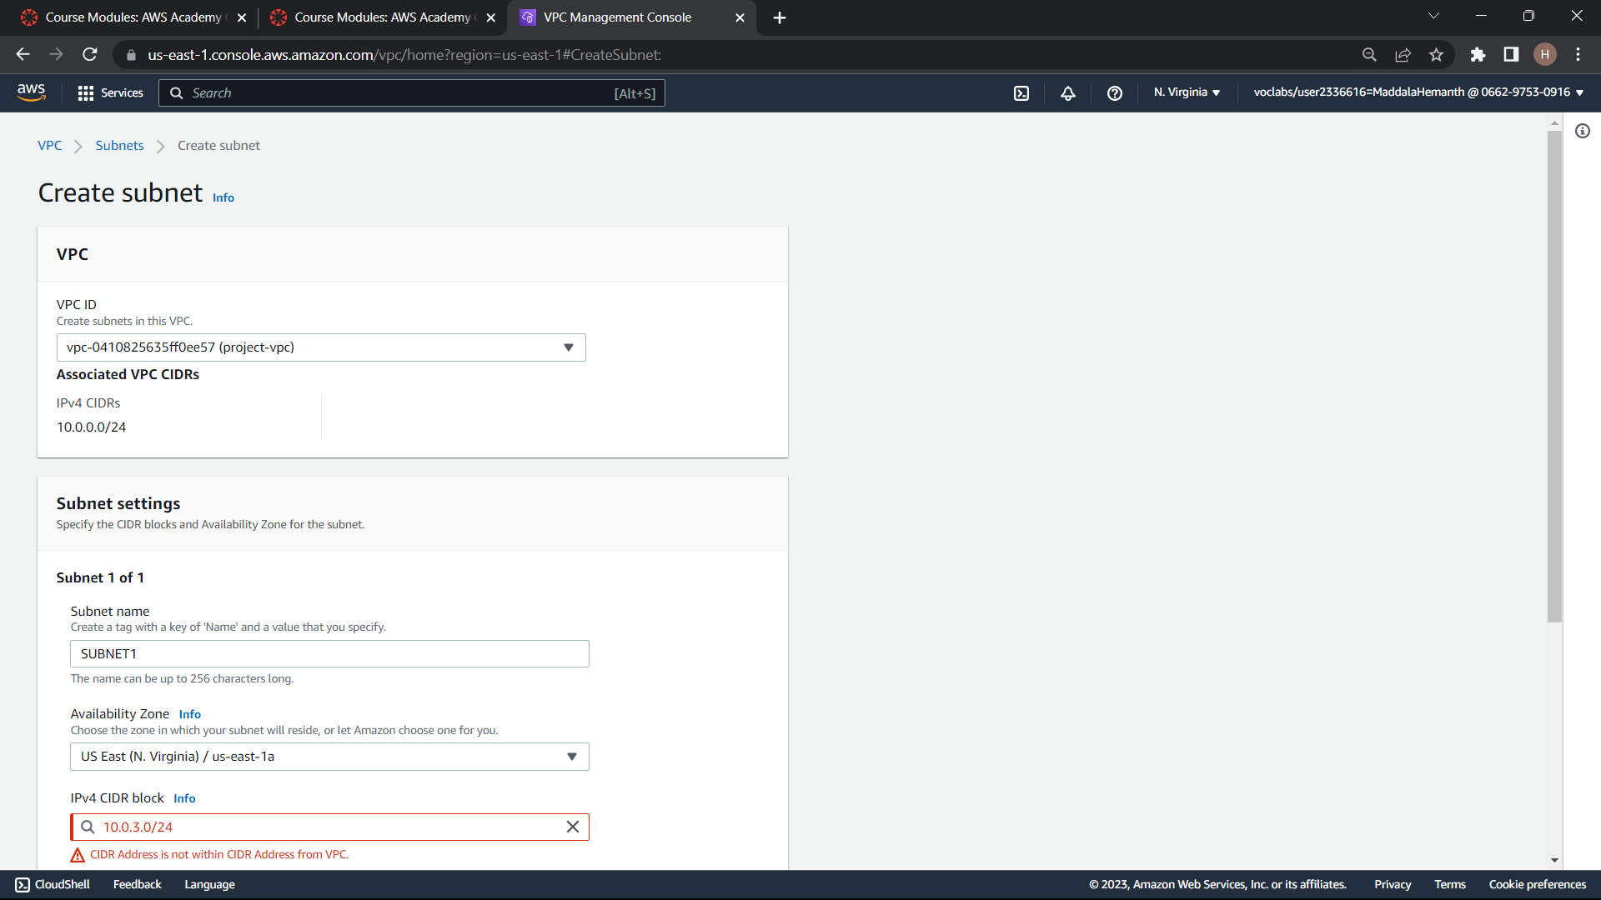

Slide 35
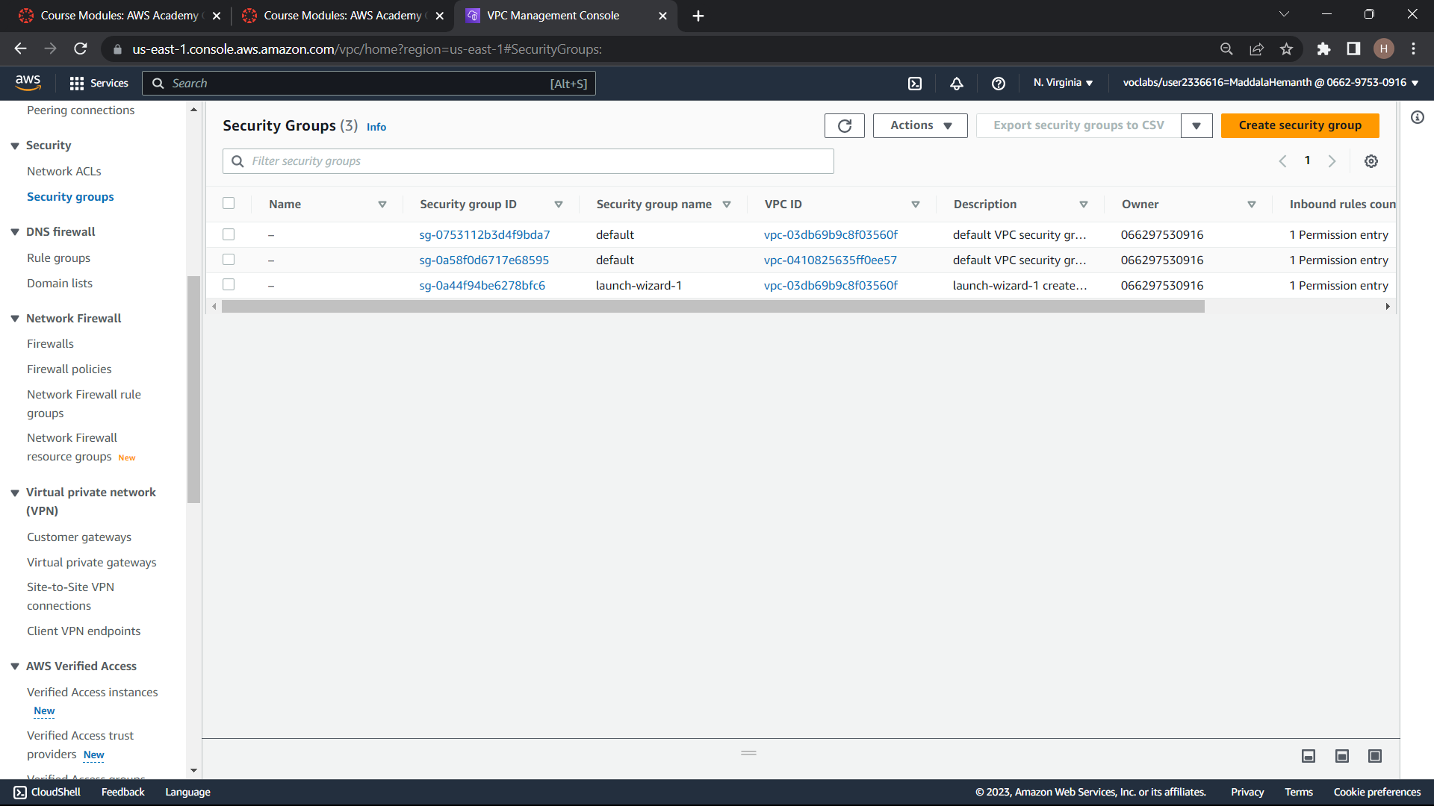

Slide 36
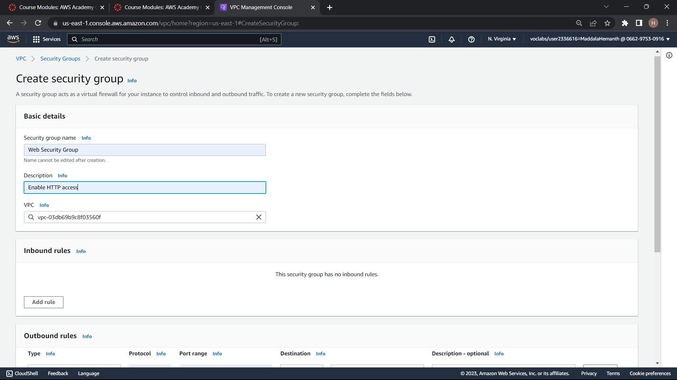

Slide 37
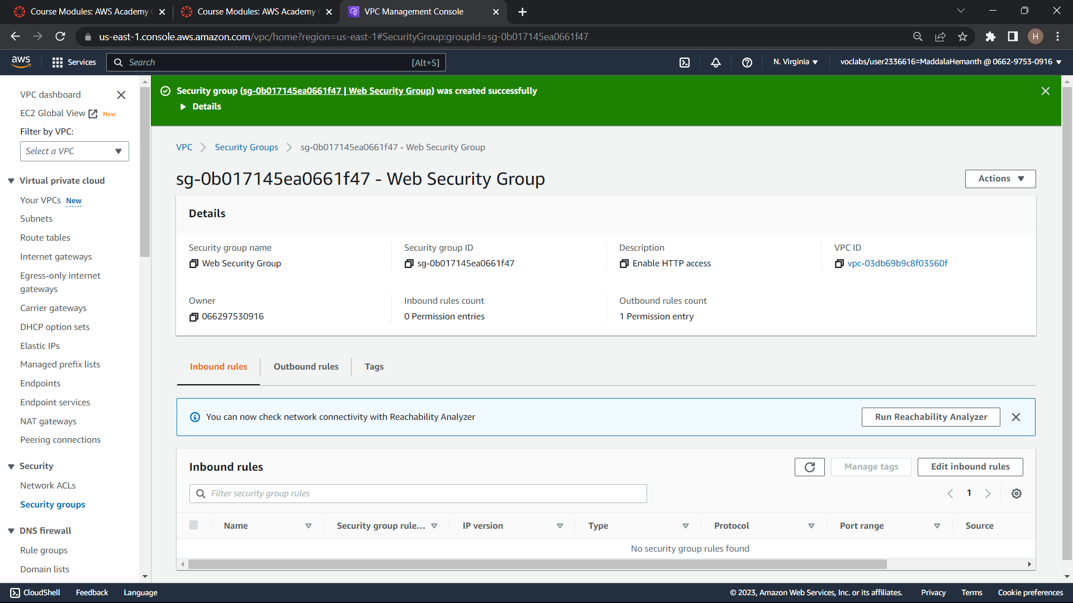

Slide 38
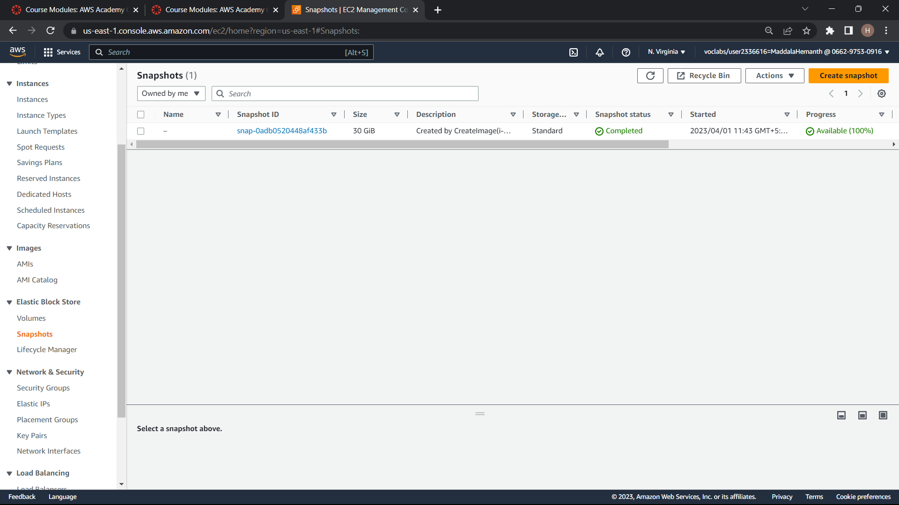
CREATE SNAPSHOT

Slide 39
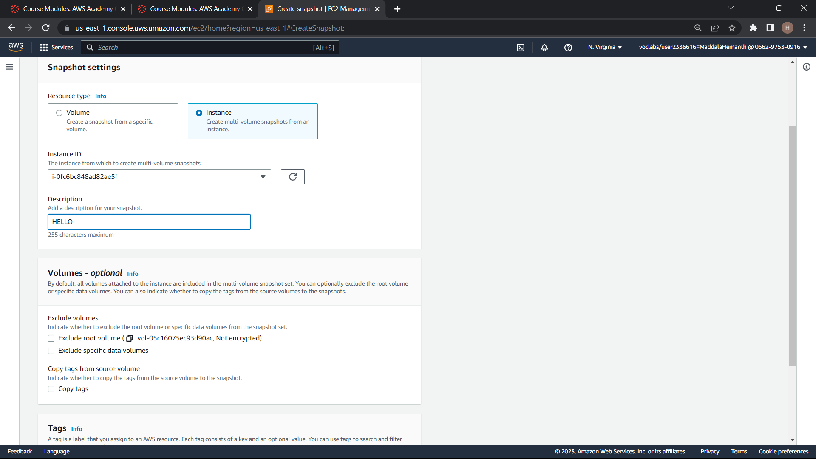

Slide 40
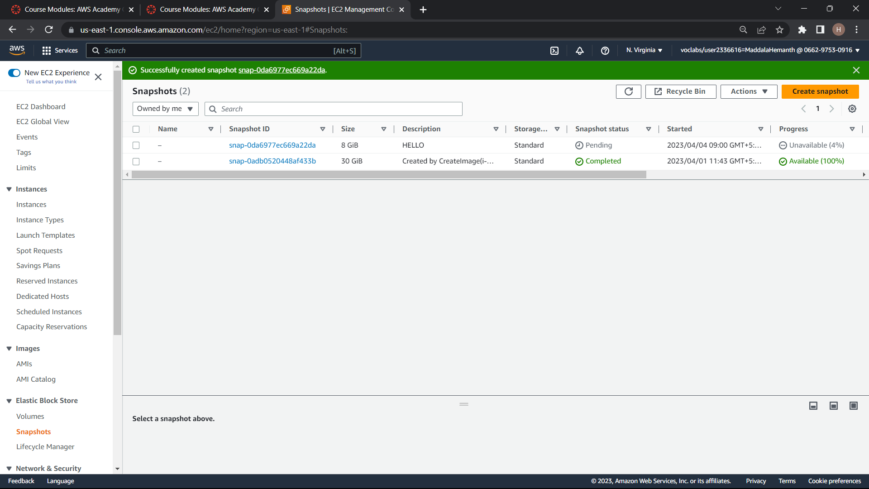

Slide 41
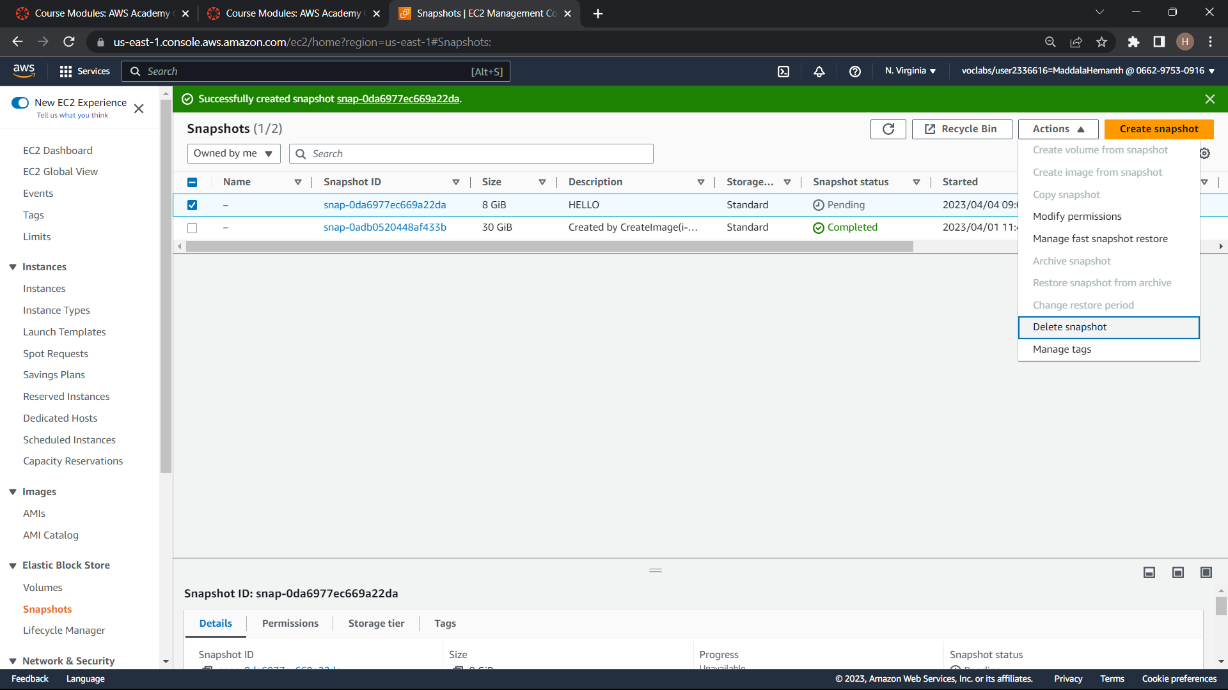

Slide 42
